Slide 1



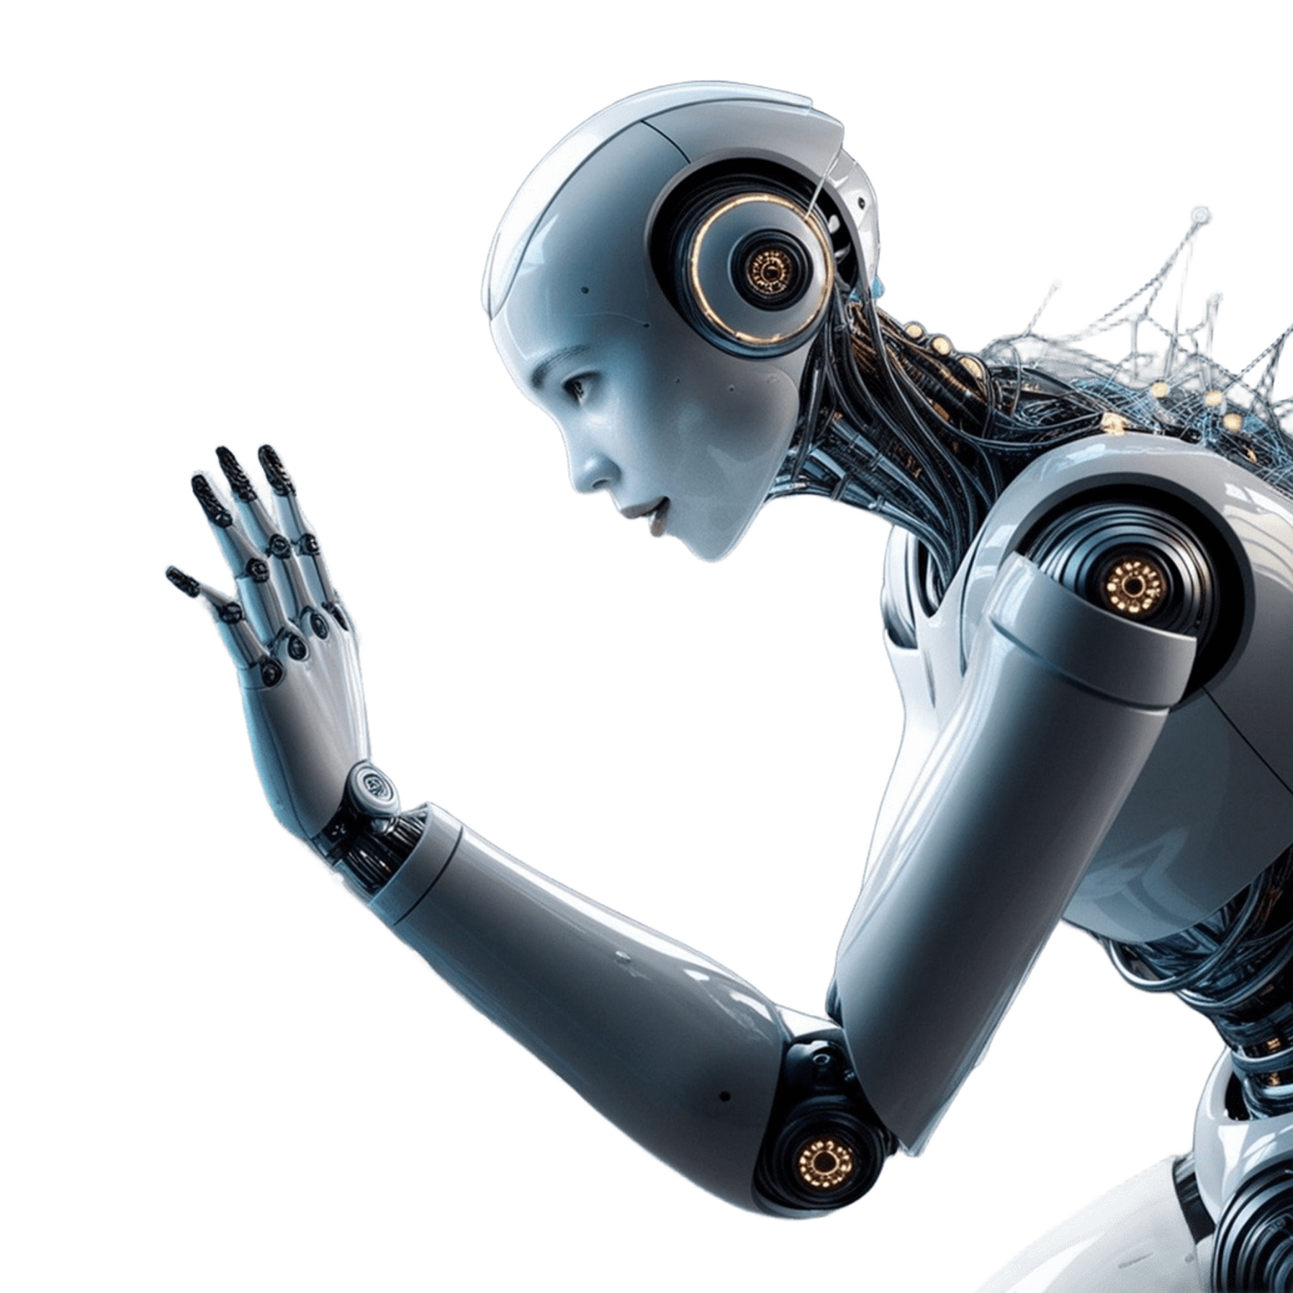



Safe People Team
INTRODUCTION
According to a survey conducted by OnePoll on behalf of Idahoan Foods, more than a quarter of respondents (28%) find dinner to be the most challenging meal to make. This suggests that a significant portion of Americans struggle with deciding what to cook for dinner each night. (studyfinds.org)
Our project will take the ingredients you have on hand and will make meal suggestions based on the recipes from your collection and/or from other sources that match your panty, cooking abilities and time to prepare.
“WHATS FOR DINNER” – a new AI driven mobile app ®

Slide 2



Safe People Team
What’s For Dinner®
Smart Enough to Know You and Your Kitchen, With Recommendations that Make Sense – And Make Dinner Easy

Slide 3






Safe People Team
Key Architecture Components Overview
The Pantry
The Recommendation Agent
The Recipe
A personalized list of key ingredients, food items and available staples you have in home .
The agent that reviews your Panty, stored recipes and preferences to recommend the perfect meal.
The suggested recipes you can make based upon set categories such as Best Match, Simplest or Quickest

Slide 4
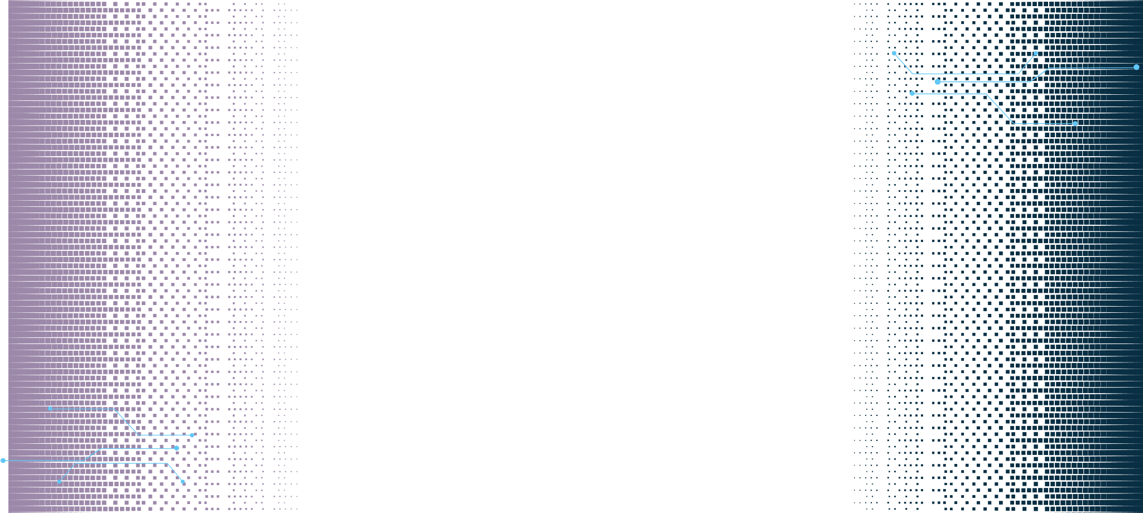



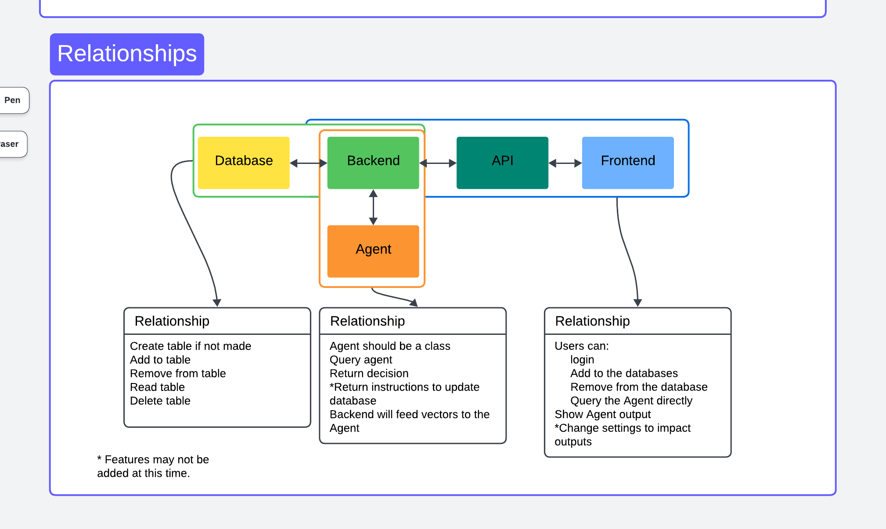




Safe People Team
Architecture Overview Diagram

Slide 5






Safe People Team
KEY TECHNOLOGIES
JSON
FastAPI
High-performance web framework for building API’s with Python
Lightweight data interchange format for easy parse and generate
OLLAMA 3.2
SQL Lite
LLM with smaller sized models and multimodal capabilities
Lightweight, self-contained, serverless reliable SQL database engine

Slide 6

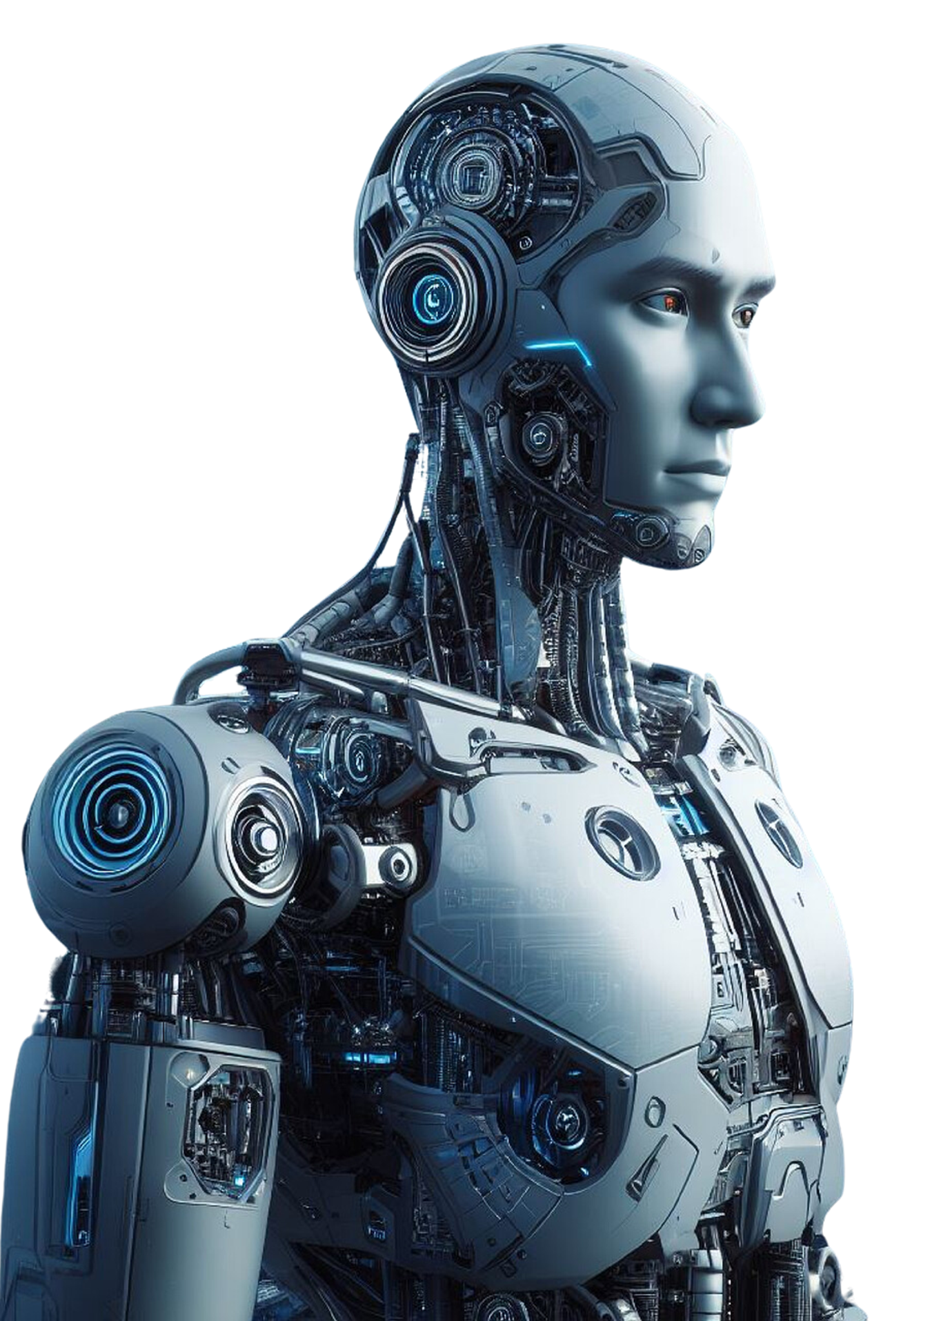

Safe People Team
OTHER GOALS
At project core, we will focus on making sure our solution can make agent provided recommendations using items from the Pantry.
But we will also spend project time on:
Have the Agent Make Time Based Recommendations (AM/PM)
Add Items to Pantry Using Photo’s (Take a picture of your fridge)
Have the Agent Make Conversion or Calorie Estimates (cups = tablespoons)
Add missing ingredients to a Shopping List (Walmart Amazon)

Slide 7
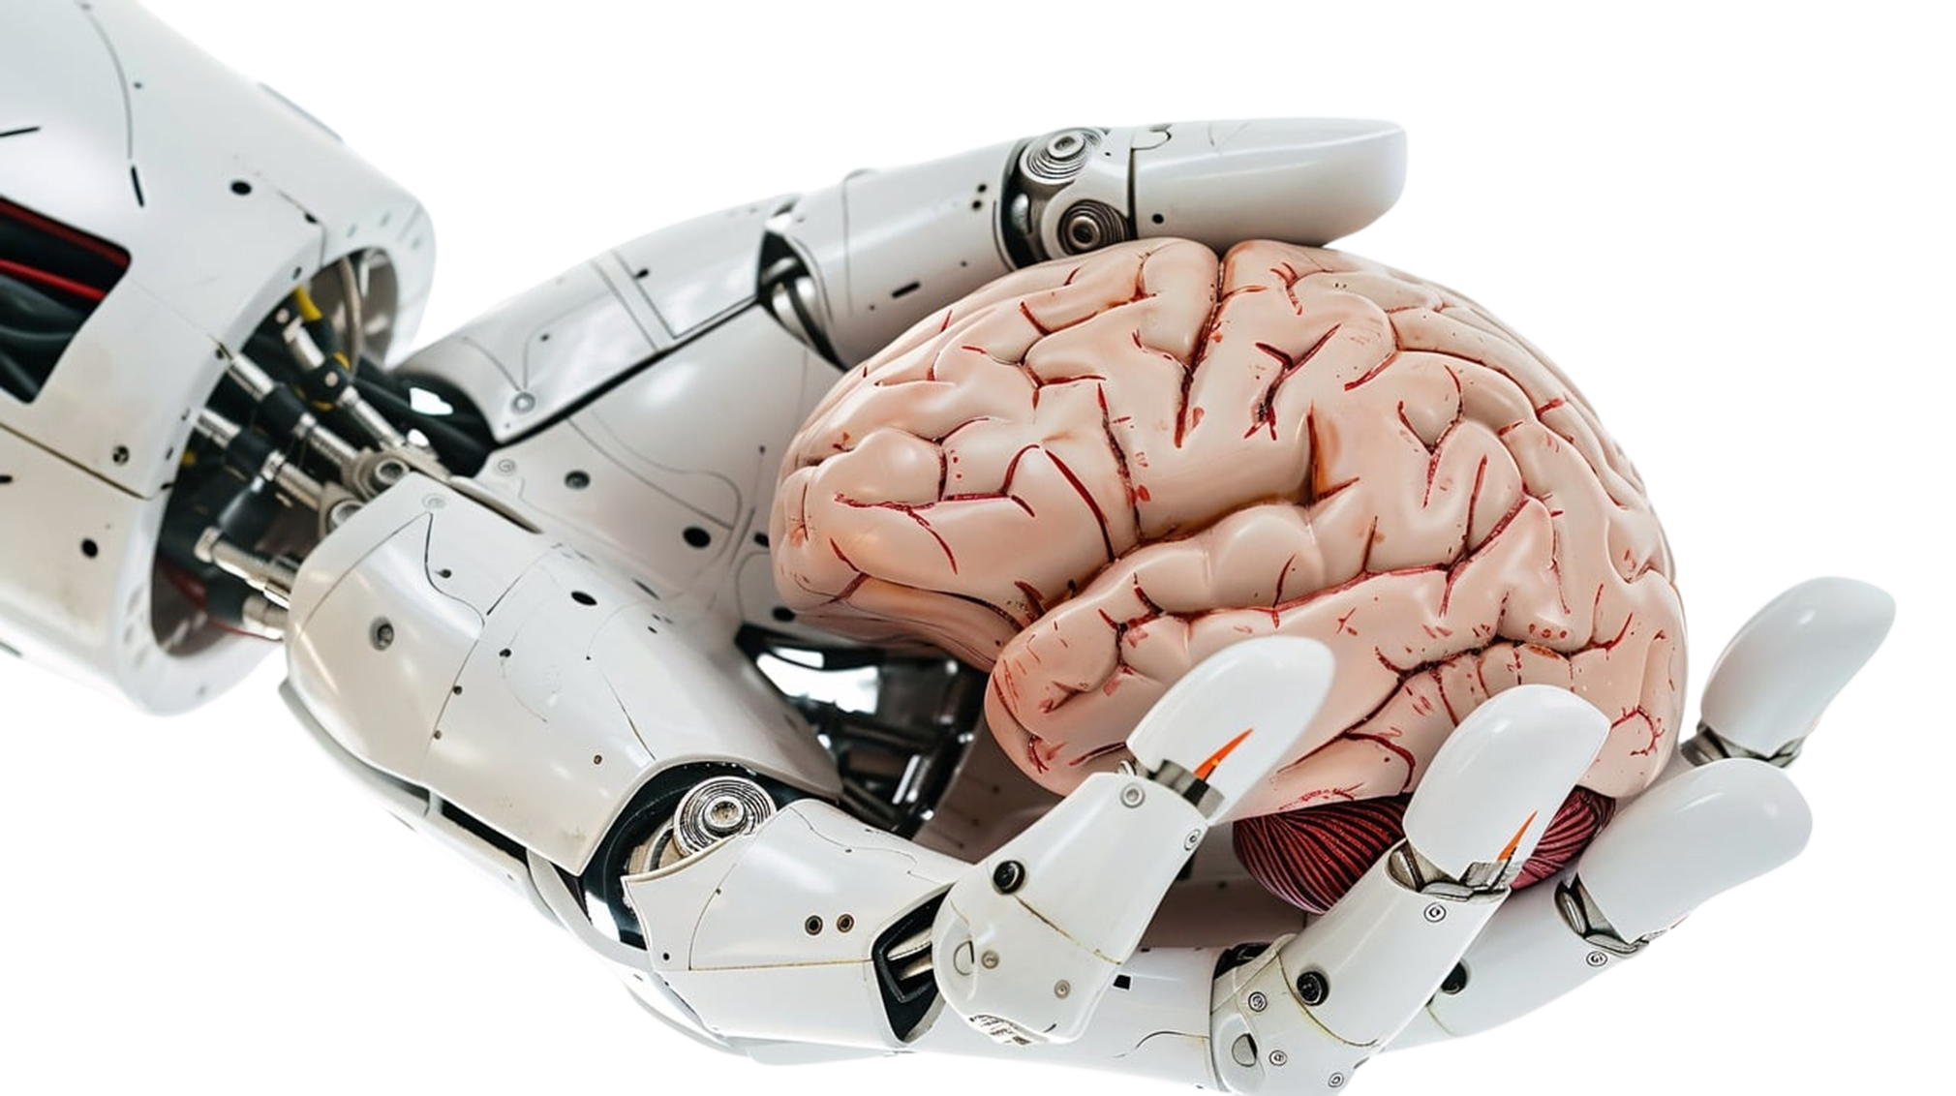

Safe People Team
MEET THE TEAM
We are the original SAFE PEOPLE team.
We are a group of Sophomores, Juniors and Seniors in the Computer Science Department.
We have a mixed background of interest, knowledge and experience.

Slide 8


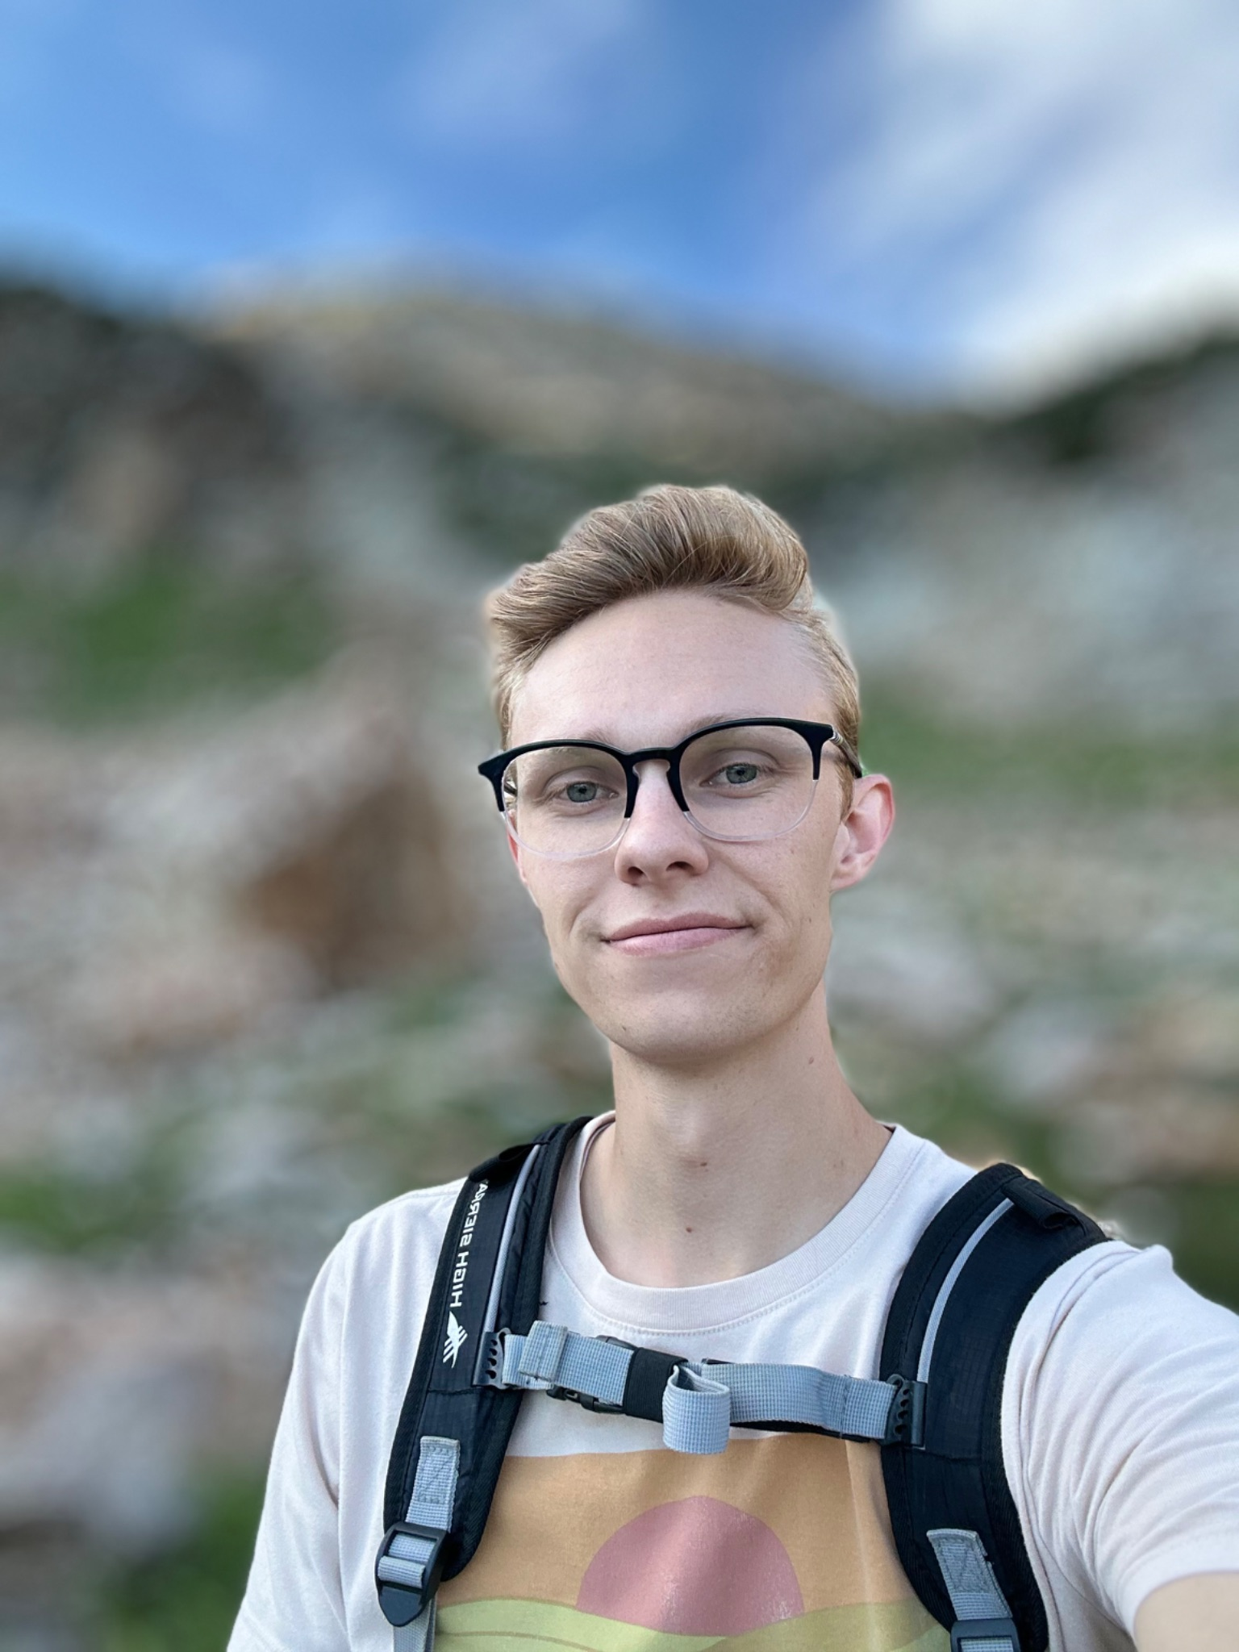
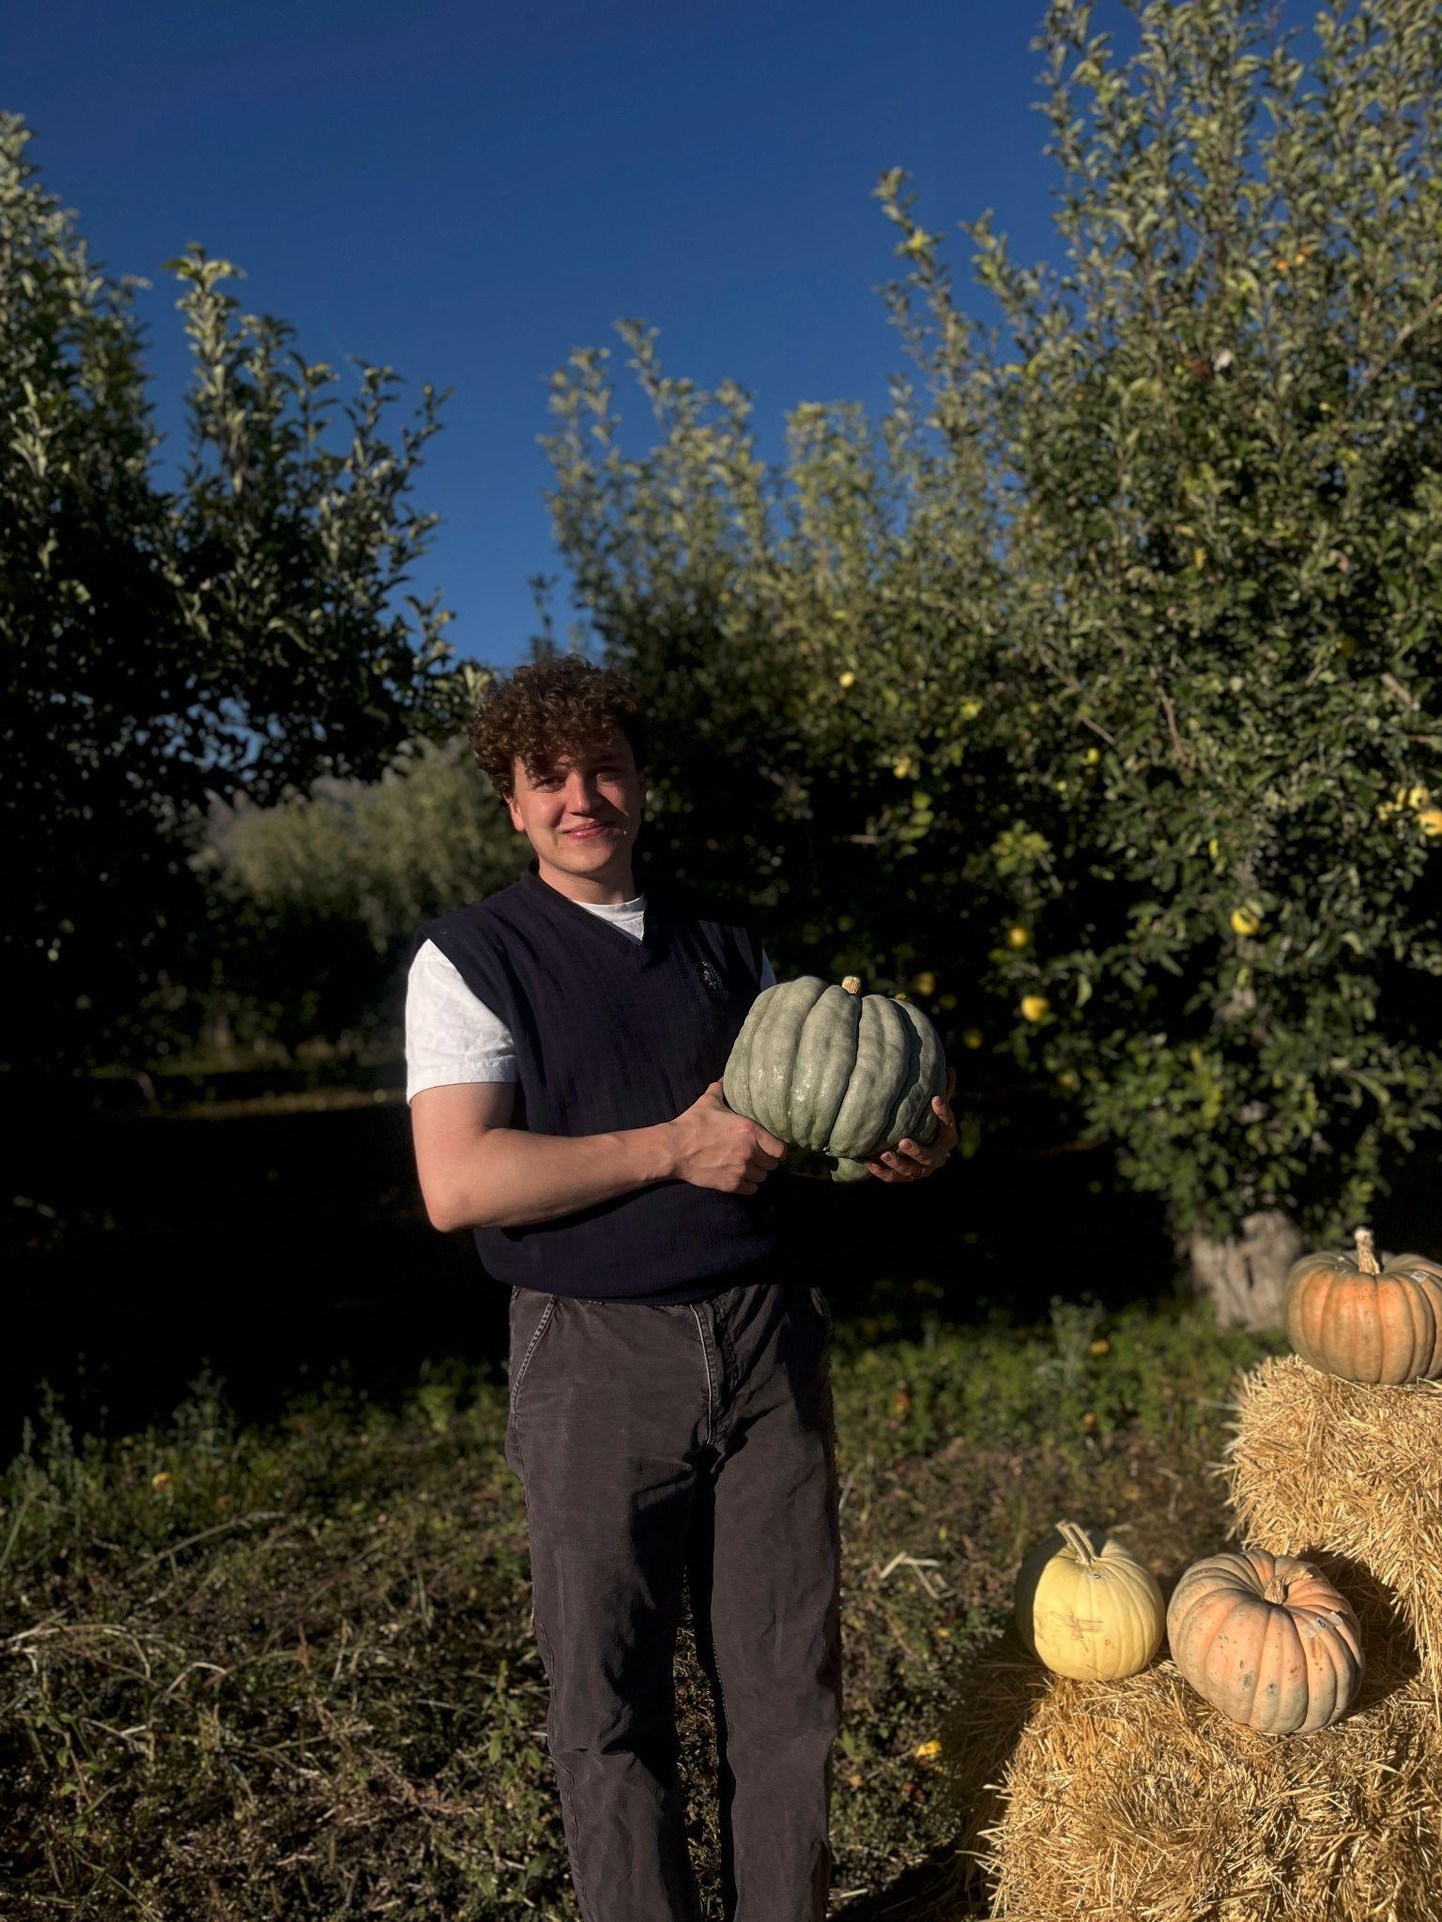
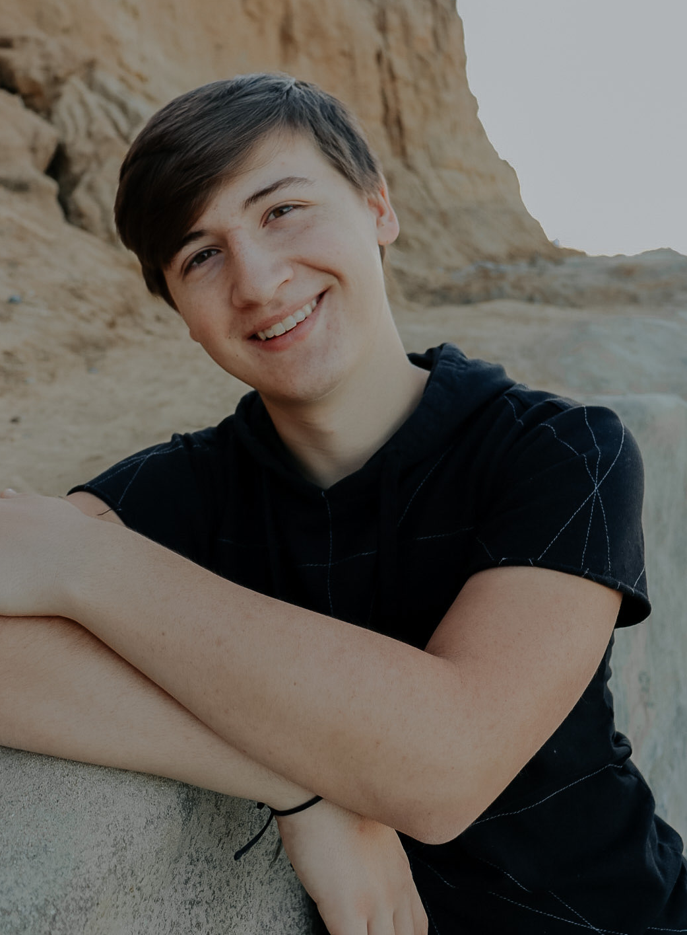
Safe People Team
PROFILES
ETHAN
MAX
CARTER
Product Owner, Developer, Designer
Researcher, Developer, Data Structures
Designer, UI/API, Nodes

Slide 9
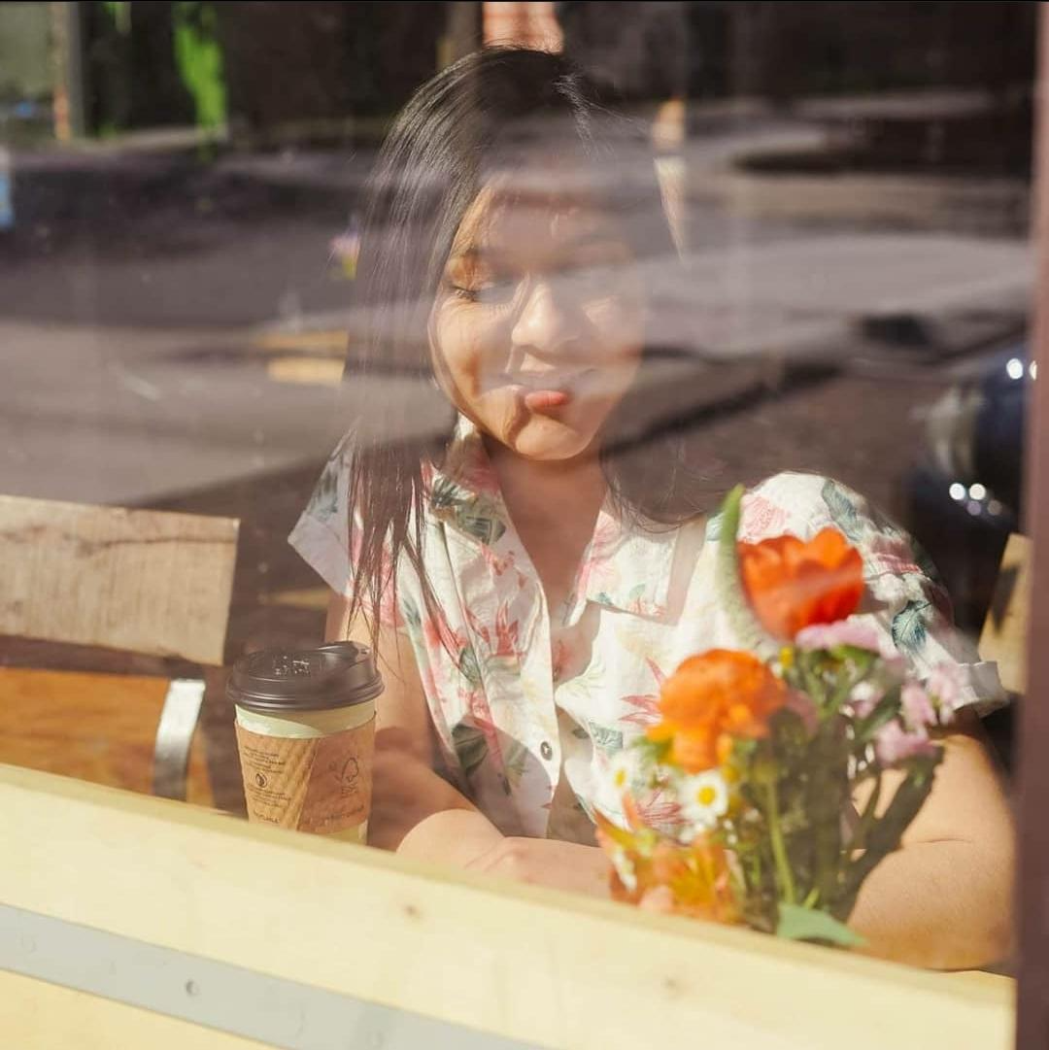
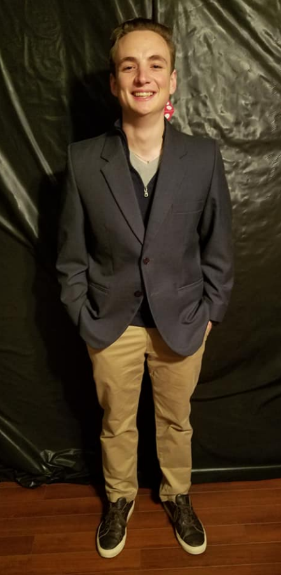
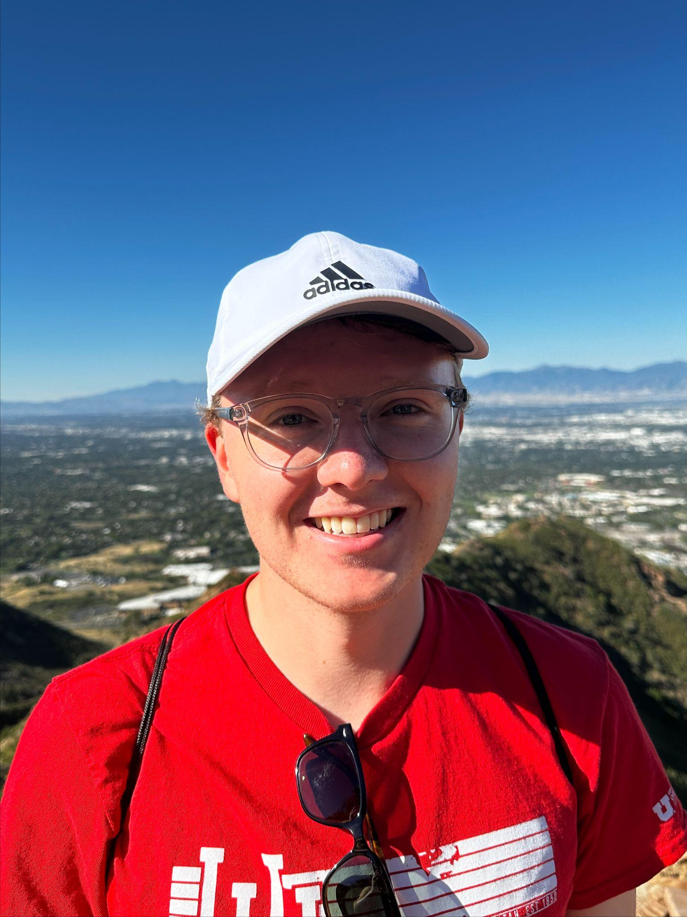
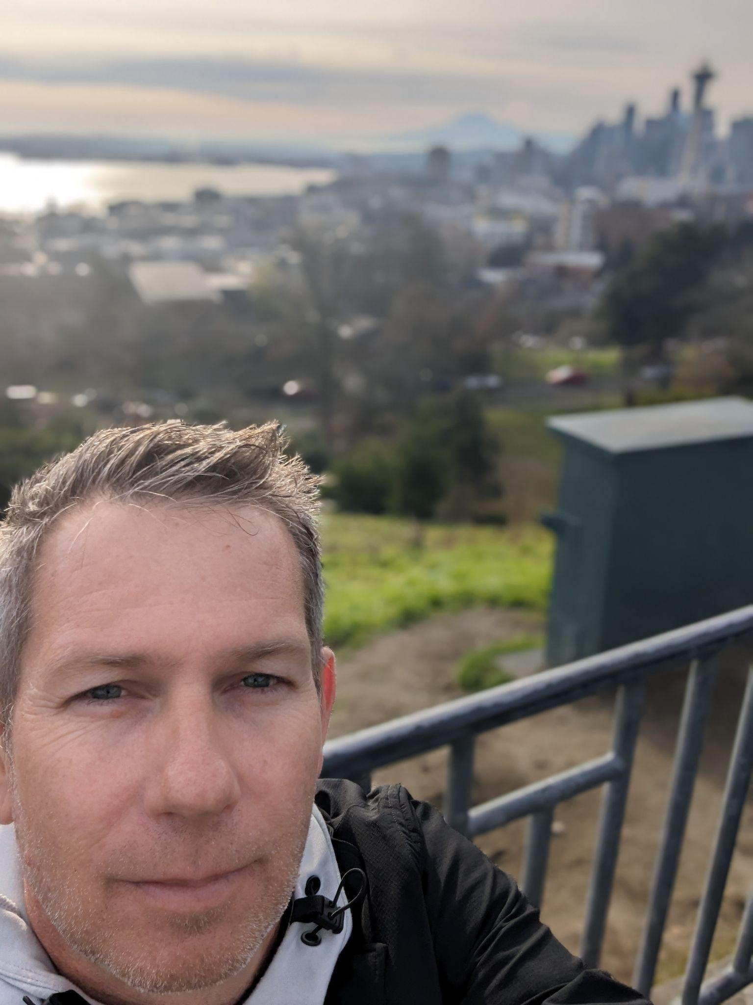
Safe People Team
PROFILES
DIANA
JAMES
JOE
Product Design, Front-end, UI
CONNOR
Developer, Designer, Server
Product Design, Documentation, Project Management
Developer/UI

Slide 10
Safe People Team
Project Presentation 10/30
Present Core Concepts to the 489R Class and Instructor Approval.
Key Project Dates
Project Presentations 11/6 - 27
Project general updates and development, including accomplishments, challenges and next steps.
Project Final Presentation 12/4
Final classroom presentation of overall solution for evaluation and grading.

Slide 11


Safe People Team
Questions?

Slide 12

Let’s Get Started!

Slide 13







Safe People Team
CS 489R
WEEK 45 Update (11/6/2024)
Purpose: Project Development Updates
Progress Presentation

Slide 14


Safe People Team
TABLE OF CONTENTS
01.
02.
03.
PROJECT OVERVIEW
DETAILS & DELIVERABLES
PROJECT TEAM
What it is and why we selected this project.
What we will deliver and how it will be built.
Who we are and how the project team is organized.

Slide 15
Safe People Team
Project Development
An overview of what has been accomplished since the previous week.
Week 45: Key Update Areas
Project Challenges
Any challenges or roadblocks faced, and how they will be addressed.
Project Next Steps
Next steps and goals for upcoming week.

Slide 16
Safe People Team
Project Development - Highlights
Architecture Updates
Front-end Updates
Updates on Presentation, Business Logic & Data Layers
Updates on Branding, Logos and User Interface Screens
Back-end Updates
Team Org Updates
Updates on technology and schema design
Updates on team organization and assignments

Slide 17
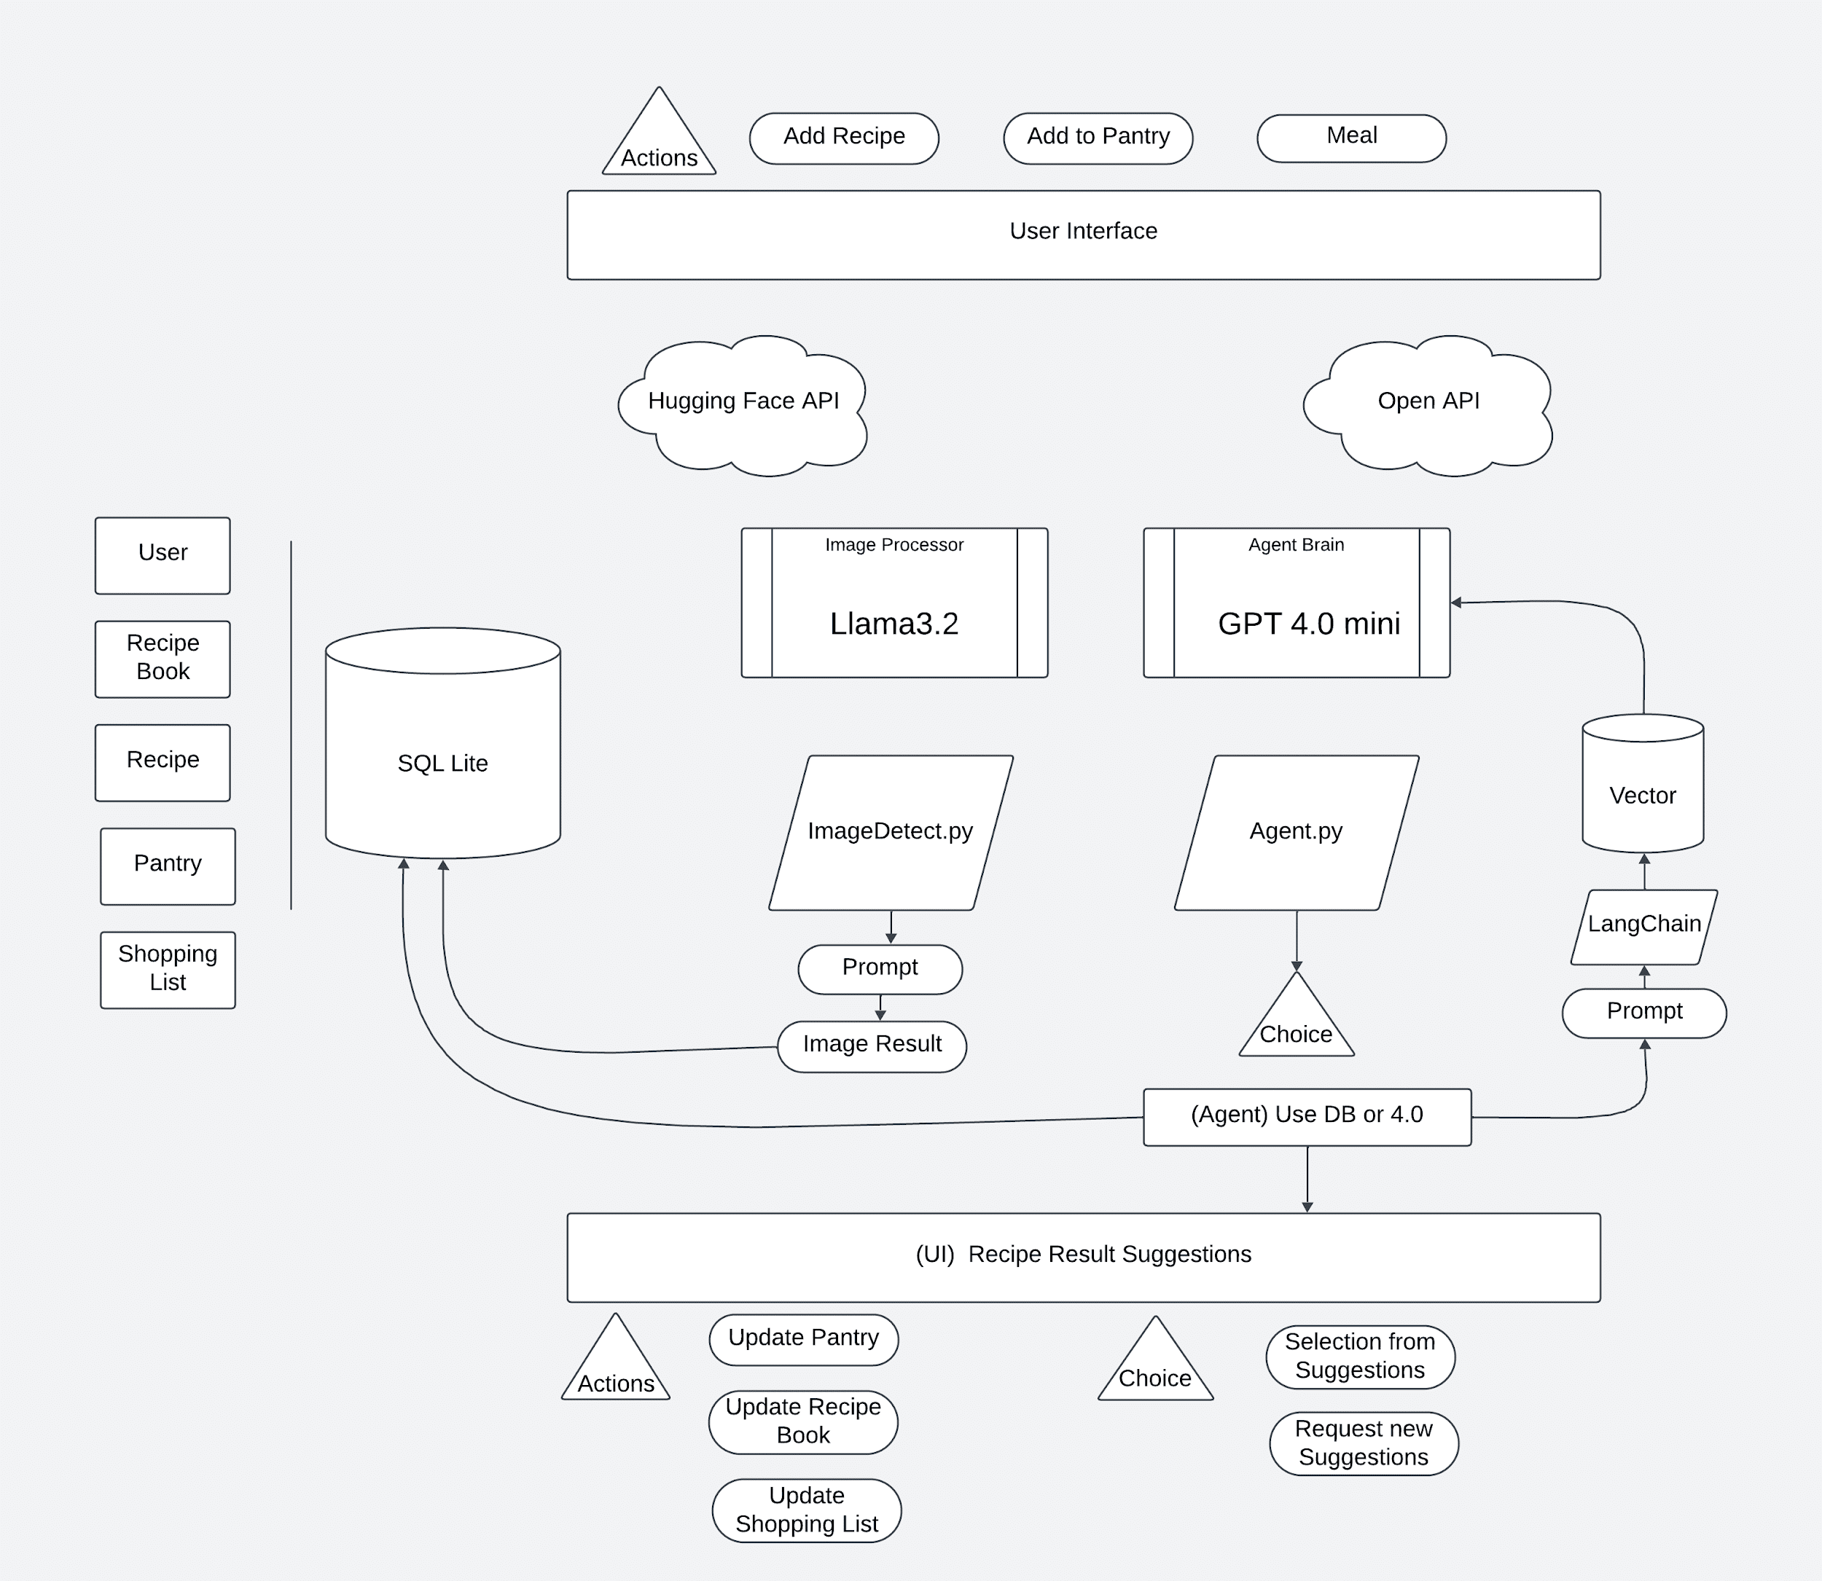
Safe People Team
Architecture Diagram
Link: https://lucid.app/lucidspark/40dc6765-fa52-4b15-a783-bf24885aff51/edit?invitationId=inv_c76da3c7-6da1-43bd-a77c-34579c441fea&page=0_0#

Slide 18








Safe People Team
FRONT-END

Slide 19
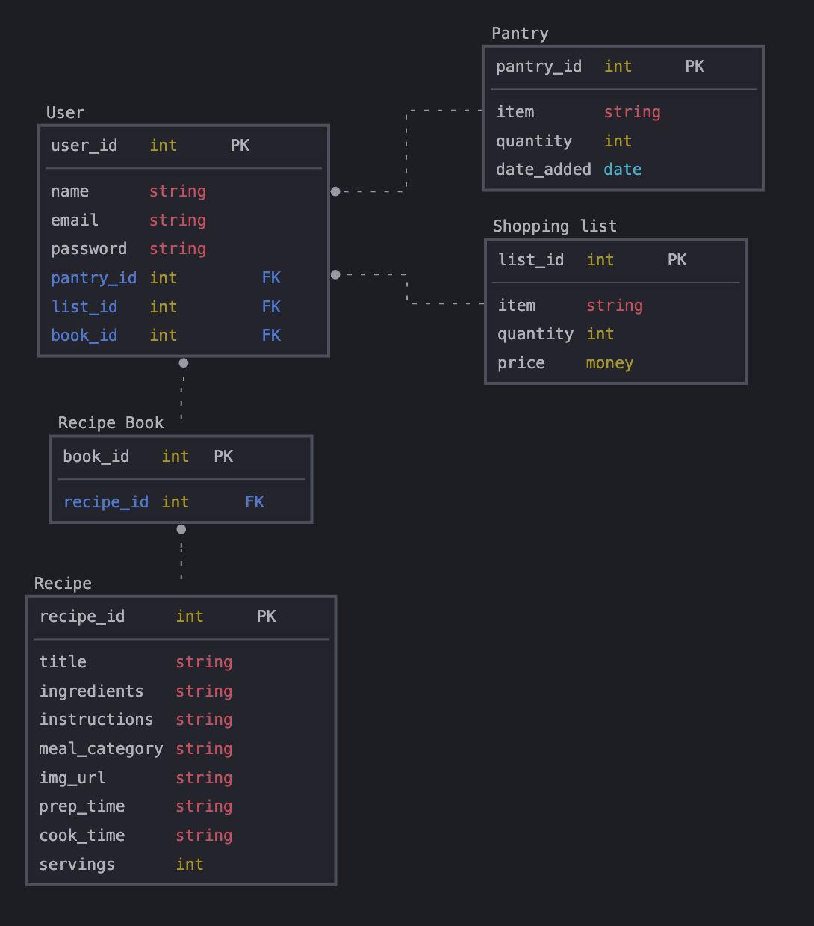
Safe People Team
Back-end Database
Highlights:
Schema
Primary Keys
Relationships
Data Types
Foreign Keys

Slide 20
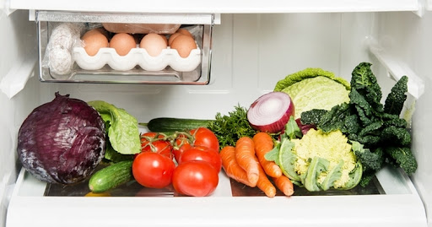
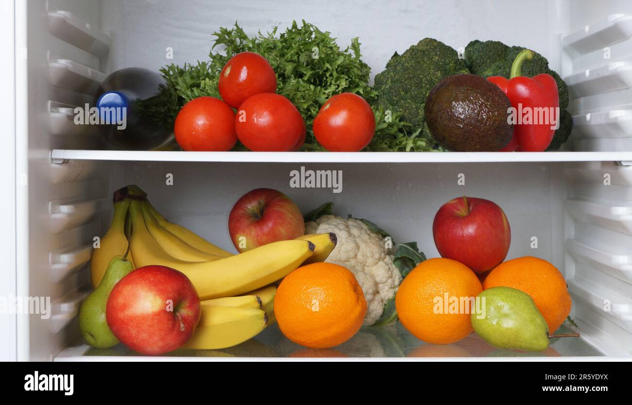
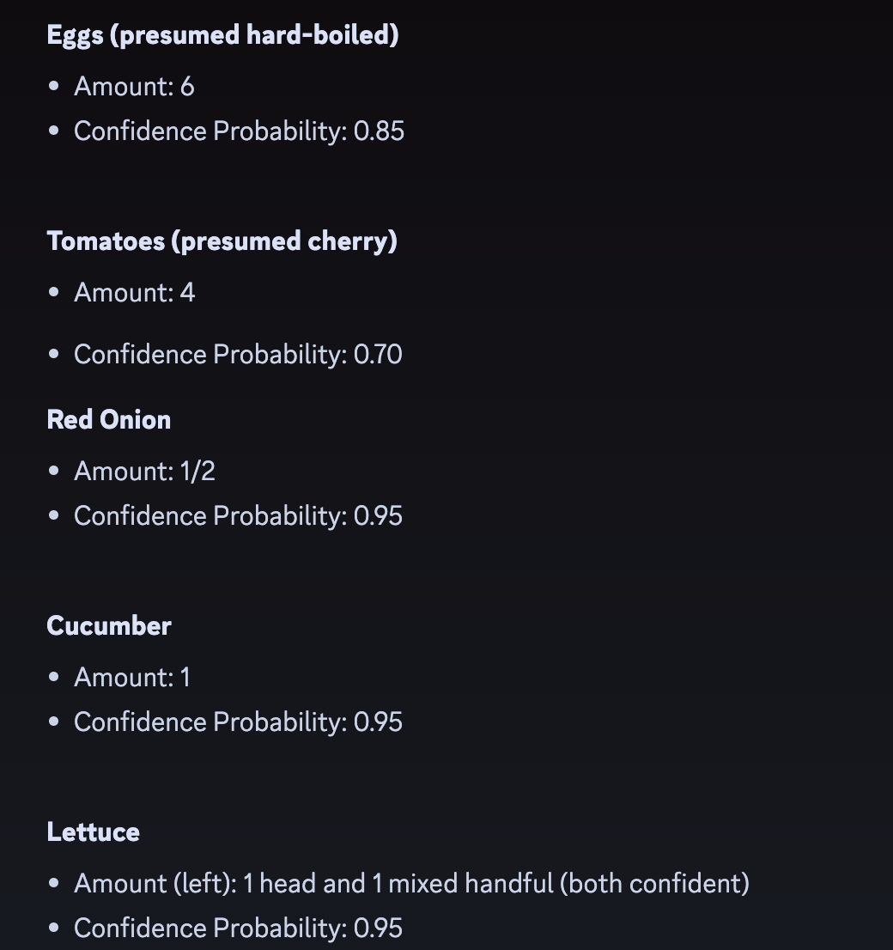
Safe People Team
YOLO(v5,v8,v11) vs LLama3.2

Slide 21
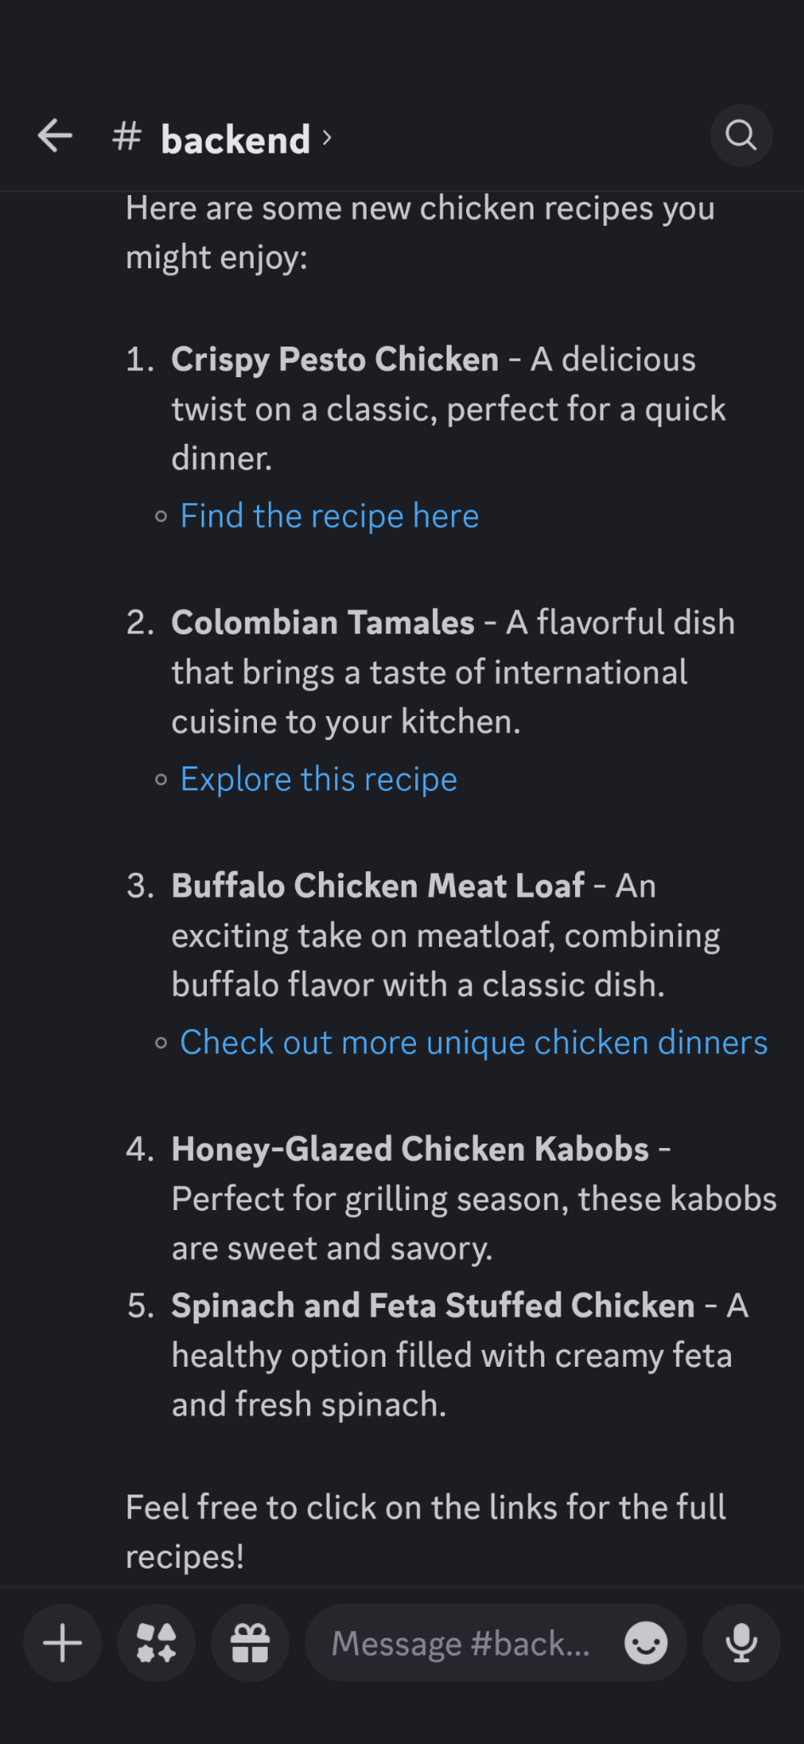
Safe People Team
Back-end Agent
Highlights:
Prompt
Query
Output
Validation
Utilization

Slide 22
Safe People Team
Project Development Summary:
1 Git Repository
5 Branches
26 Commits
232 Lines of Code

Slide 23
Safe People Team
Challenges This Week
01.
02.
03.
Foundation Model Selection
Data Types & Variables
Database Schema
Problem: How do we get the best results for vision and Agent?
Problem: Best way to pass and store Agent results.
Problem: What tables, records and views.

Slide 24
Safe People Team
Next Steps for Week 46
Front-end UI
Database Setup
Vision MOdel
Build out the Key User Interface Controls, API Events & Triggers and Pages .
Build the agreed upon data structures and data types.
Expand and improve the vision model, explore and improve on modal options

Slide 25
Safe People Team
QUESTIONS?

Slide 26
Safe People Team
CS 489R
WEEK 46 Update (11/13/2024)
Purpose: Project Development Updates
Progress Presentation

Slide 27
Safe People Team
Project Development
An overview of what has been accomplished since the previous week.
Week 46: Key Update Areas
Project Challenges
Any challenges or roadblocks faced, and how they will be addressed.
Project Next Steps
Next steps and goals for upcoming week.

Slide 28
Safe People Team
Project Development - Highlights
Architecture Updates
Front-end Updates
Updates on Decision Architecture, Models and Agents
Updates on Branding, Logos and User Interface
Back-end Updates
Vision Updates
Updates on Database, Payloads and Schema Design
Updates on Ingredient & Pantry Engine & Architecture

Slide 29
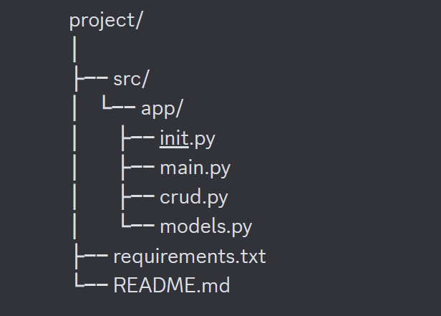
Safe People Team
Architecture
Highlights:
Repository Restructure
JSON Payloads
User Authentication

Slide 30
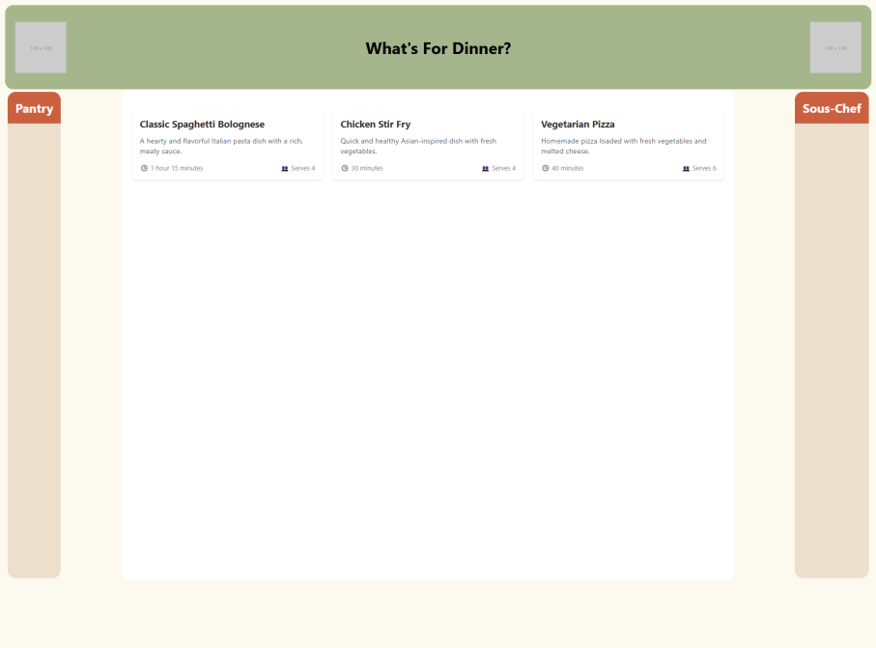
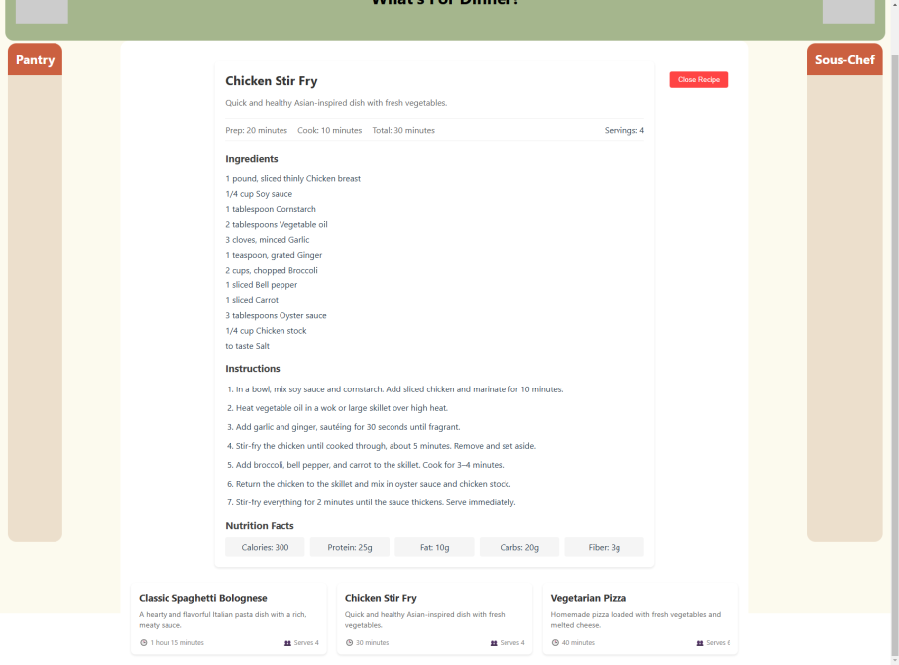
Safe People Team
FRONT-END
Highlights:
Design Layout
Recipe Collection
Recipe Card

Slide 31
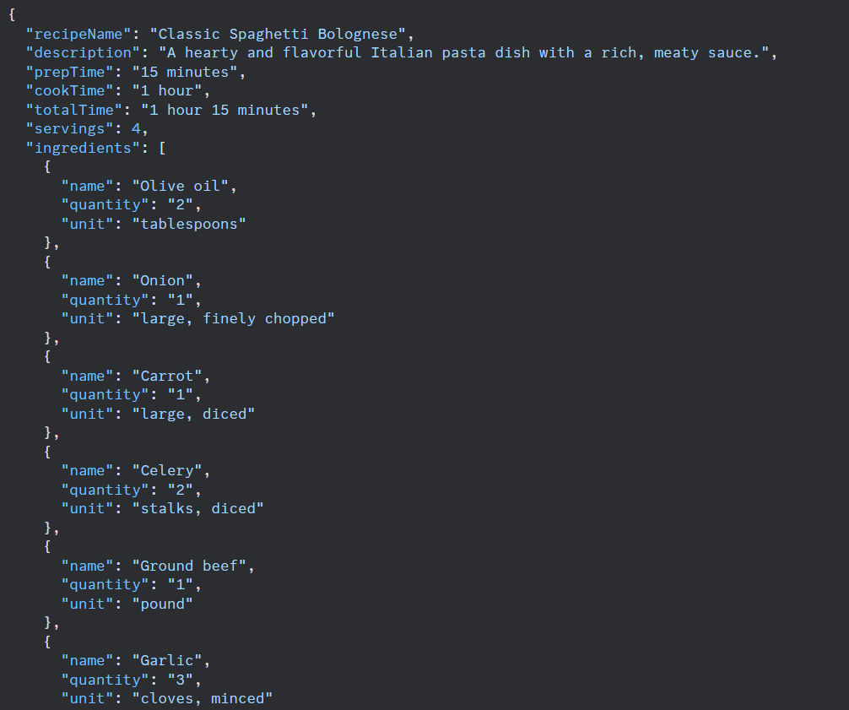
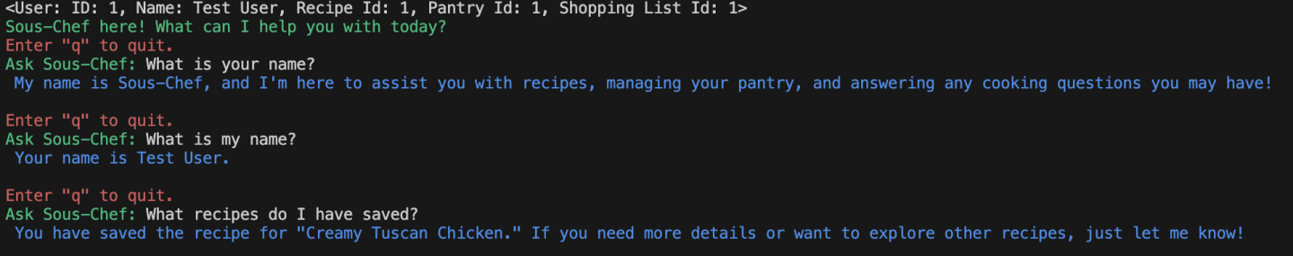
Safe People Team
Back-end Database
Highlights:
Table Population
Recipe Table
Recipe Info
Account Info

Slide 32
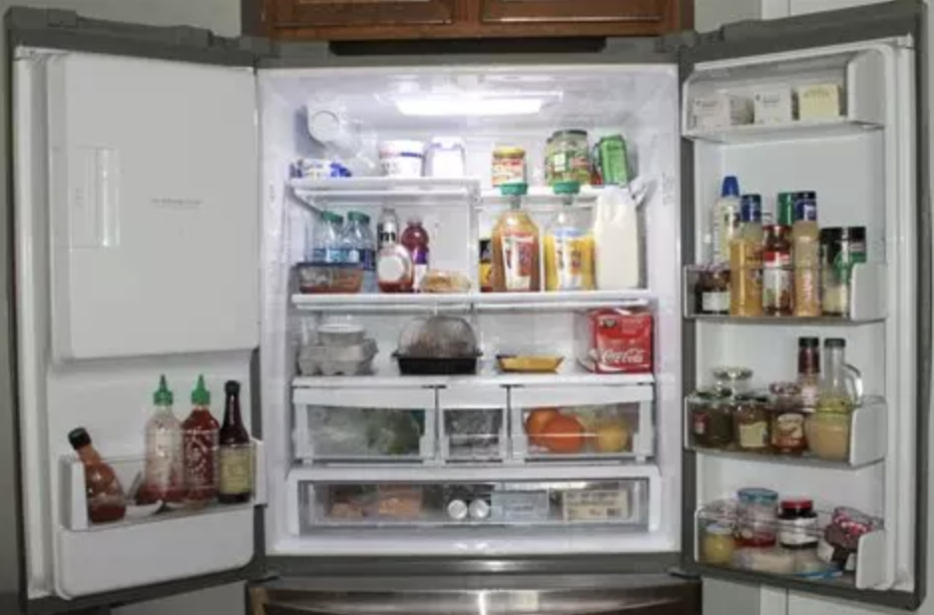
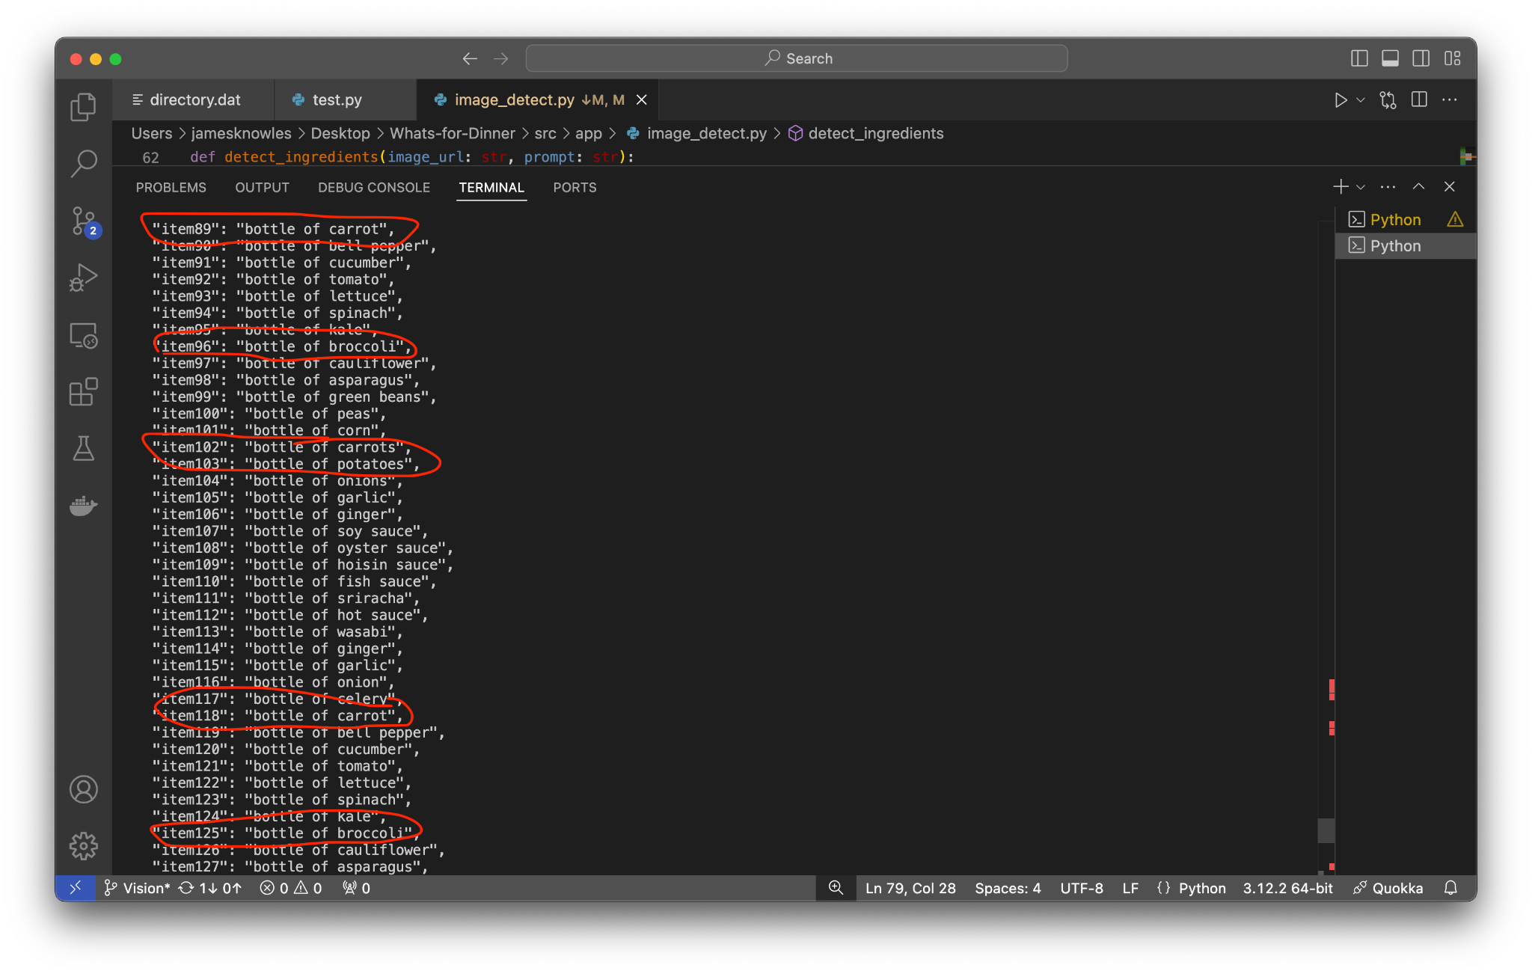
Safe People Team
Vision Progress
“Bottle of carrot”
“Bottle of broccoli”
“Bottle of carrots”
“Bottle of carrot”
“Bottle of broccoli”

Slide 33
Safe People Team
Challenges This Week
01.
02.
03.
Passing User Data to the Agent
Accuracy and Format for Vision Agent
Managing User Credentials
Problem: How do we get User Data to the Model Query?
Problem: How to we get consistent formatting in results?
Problem: How do we want to handle Username & Passwords?

Slide 34
Safe People Team
Next Steps for Week 47
Front-end UI
System Integration
Testing
Add additional user controls and functionality.
Tie different components of the application together
Validate key areas of operations, data and architecture

Slide 35

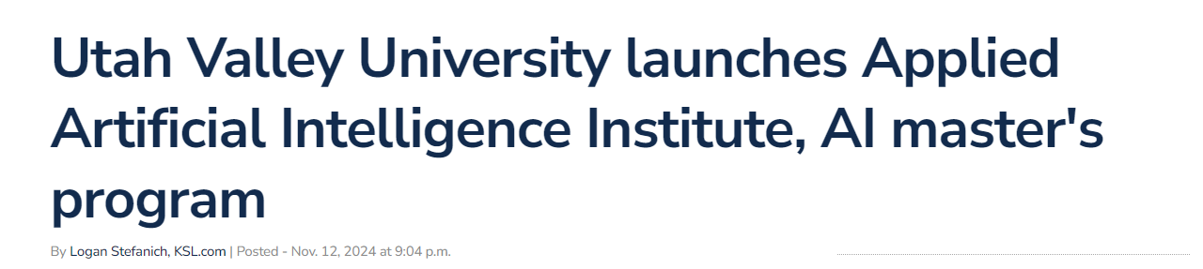
Safe People Team
Did You Know: ‘Rachel Hutchings will lead the new Program’
https://www.ksl.com/article/51188081/utah-valley-university-launches-applied-artificial-intelligence-institute-ai-masters-program

Slide 36
Safe People Team
QUESTIONS?

Slide 37
Safe People Team
CS 489R
WEEK 47 Update (11/20/2024)
Purpose: Project Development Updates
Progress Presentation

Slide 38
Safe People Team
Project Development
An overview of what has been accomplished since the previous week.
Week 47: Key Update Areas
Project Challenges
Any challenges or roadblocks faced, and how they will be addressed.
Project Next Steps
Next steps and goals for upcoming week.

Slide 39
Safe People Team
Project Development - Highlights
Architecture Updates
Front-end Updates
Updates on Decision Architecture, Models and Agents
Updates on Branding, Logos and User Interface
Back-end Updates
Vision Updates
Updates on Database, Payloads and Schema Design
Updates on Ingredient & Pantry Engine & Architecture

Slide 40
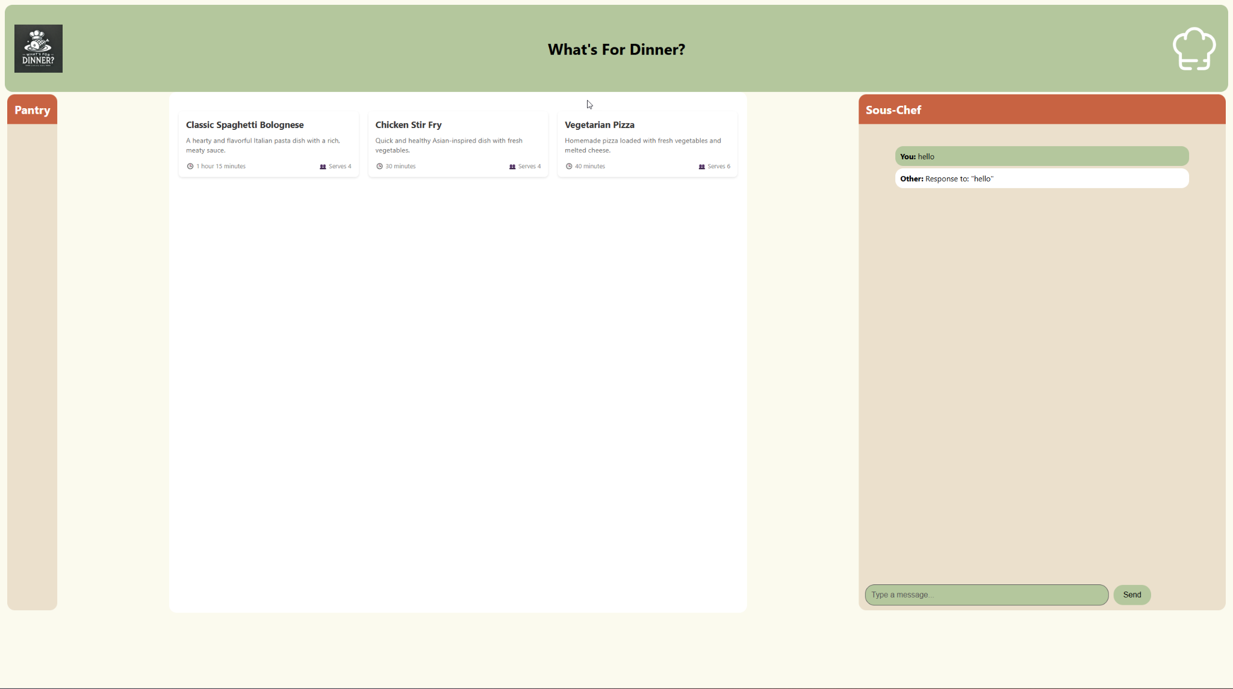
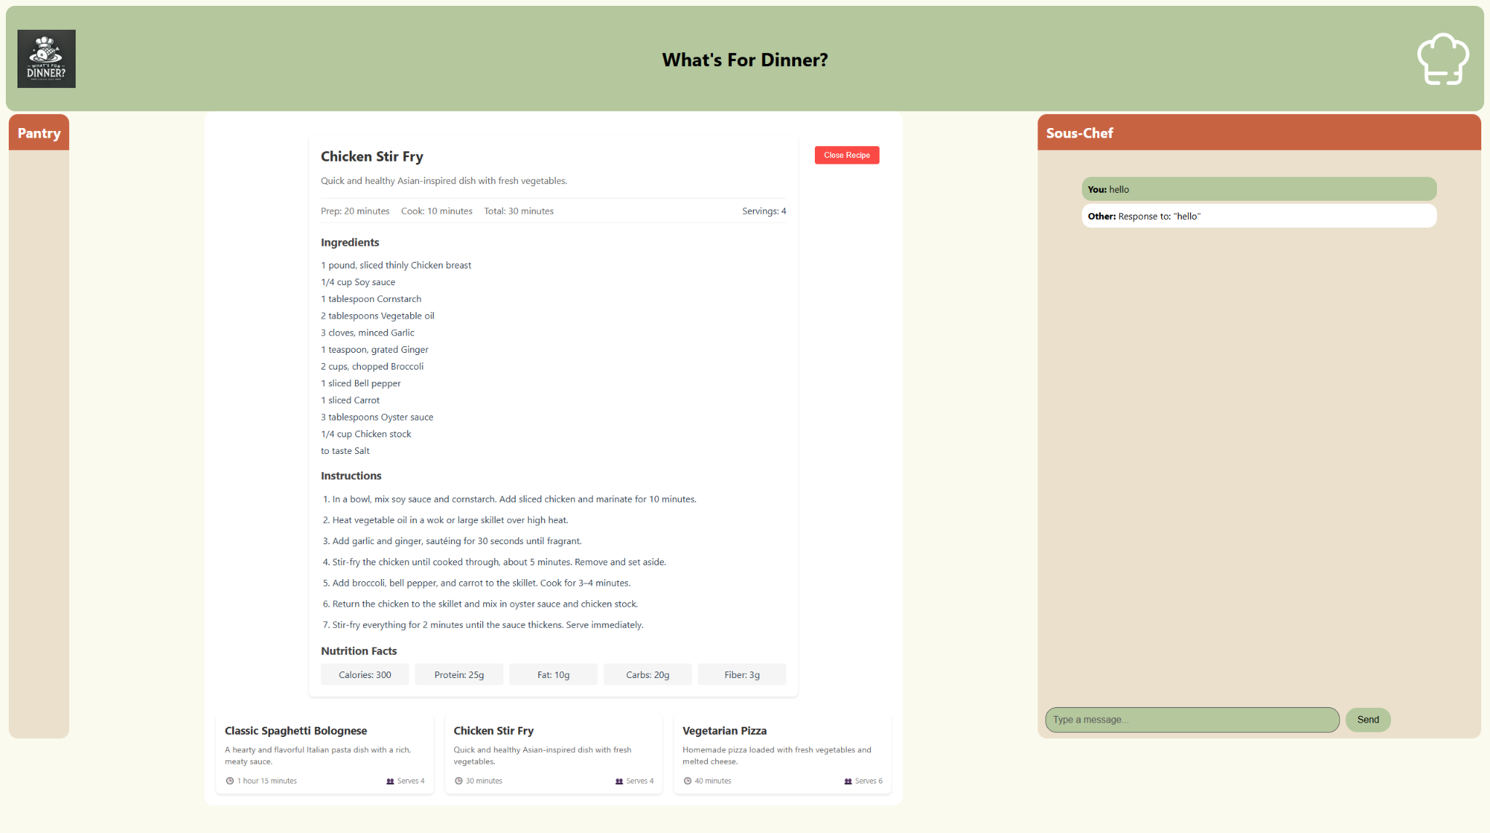
Safe People Team
FRONT-END
Highlights:
Design Layout
Recipe Collection
Recipe Card
Chat w/Sous-Chef

Slide 41
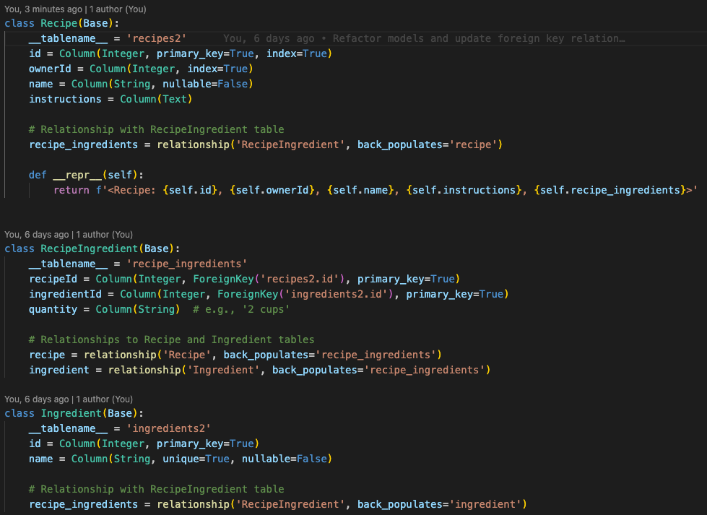
Safe People Team
Back-end Database
Highlights:
Table Population
Testing new Recipe Table
Ingredients are connected by relationship to Recipes

Slide 42
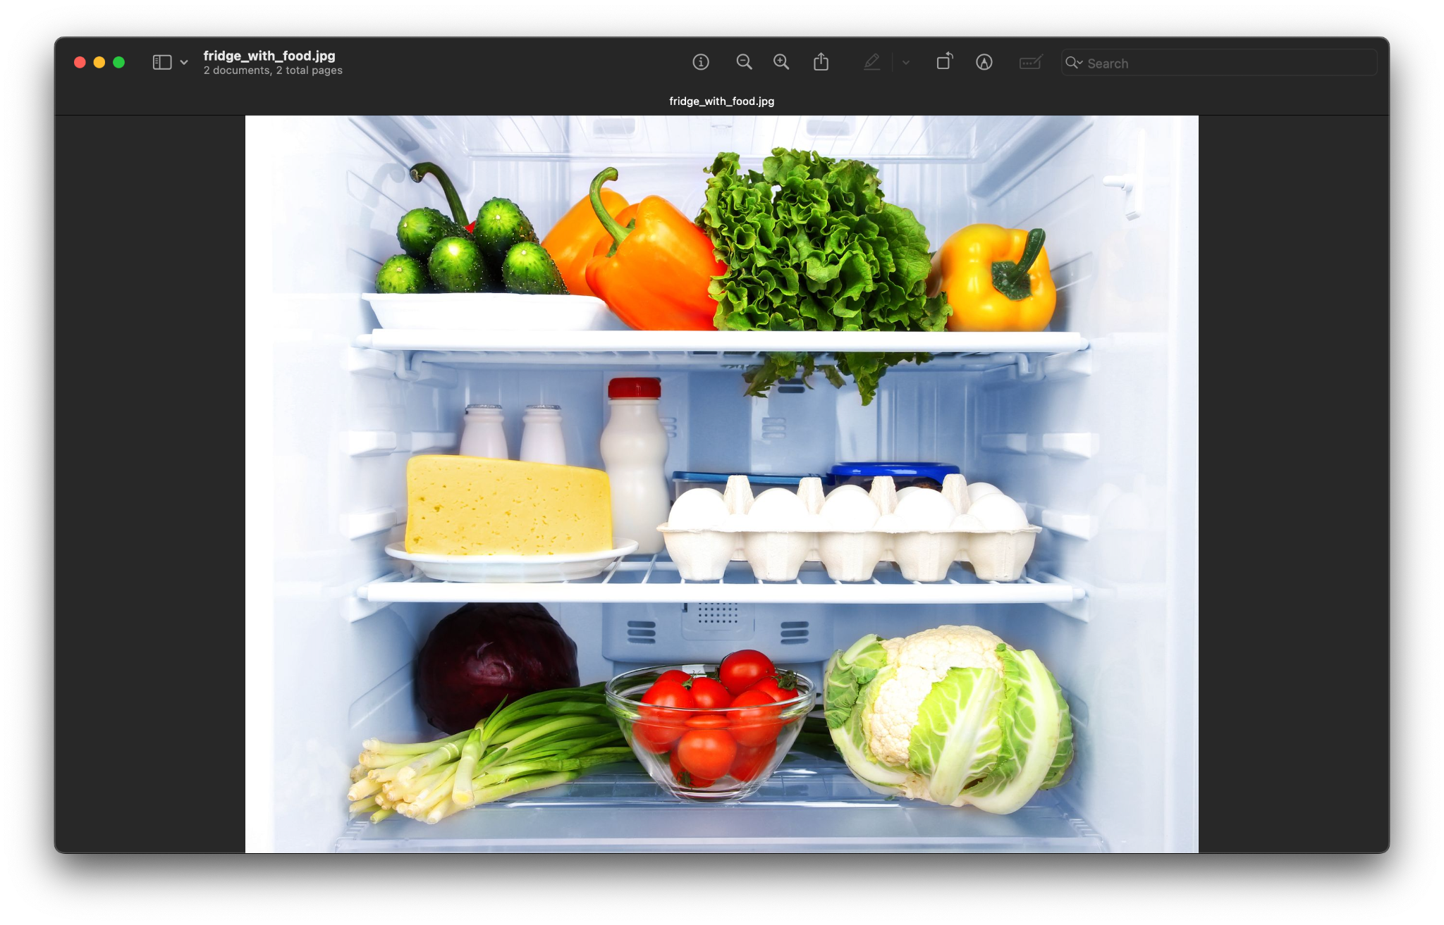
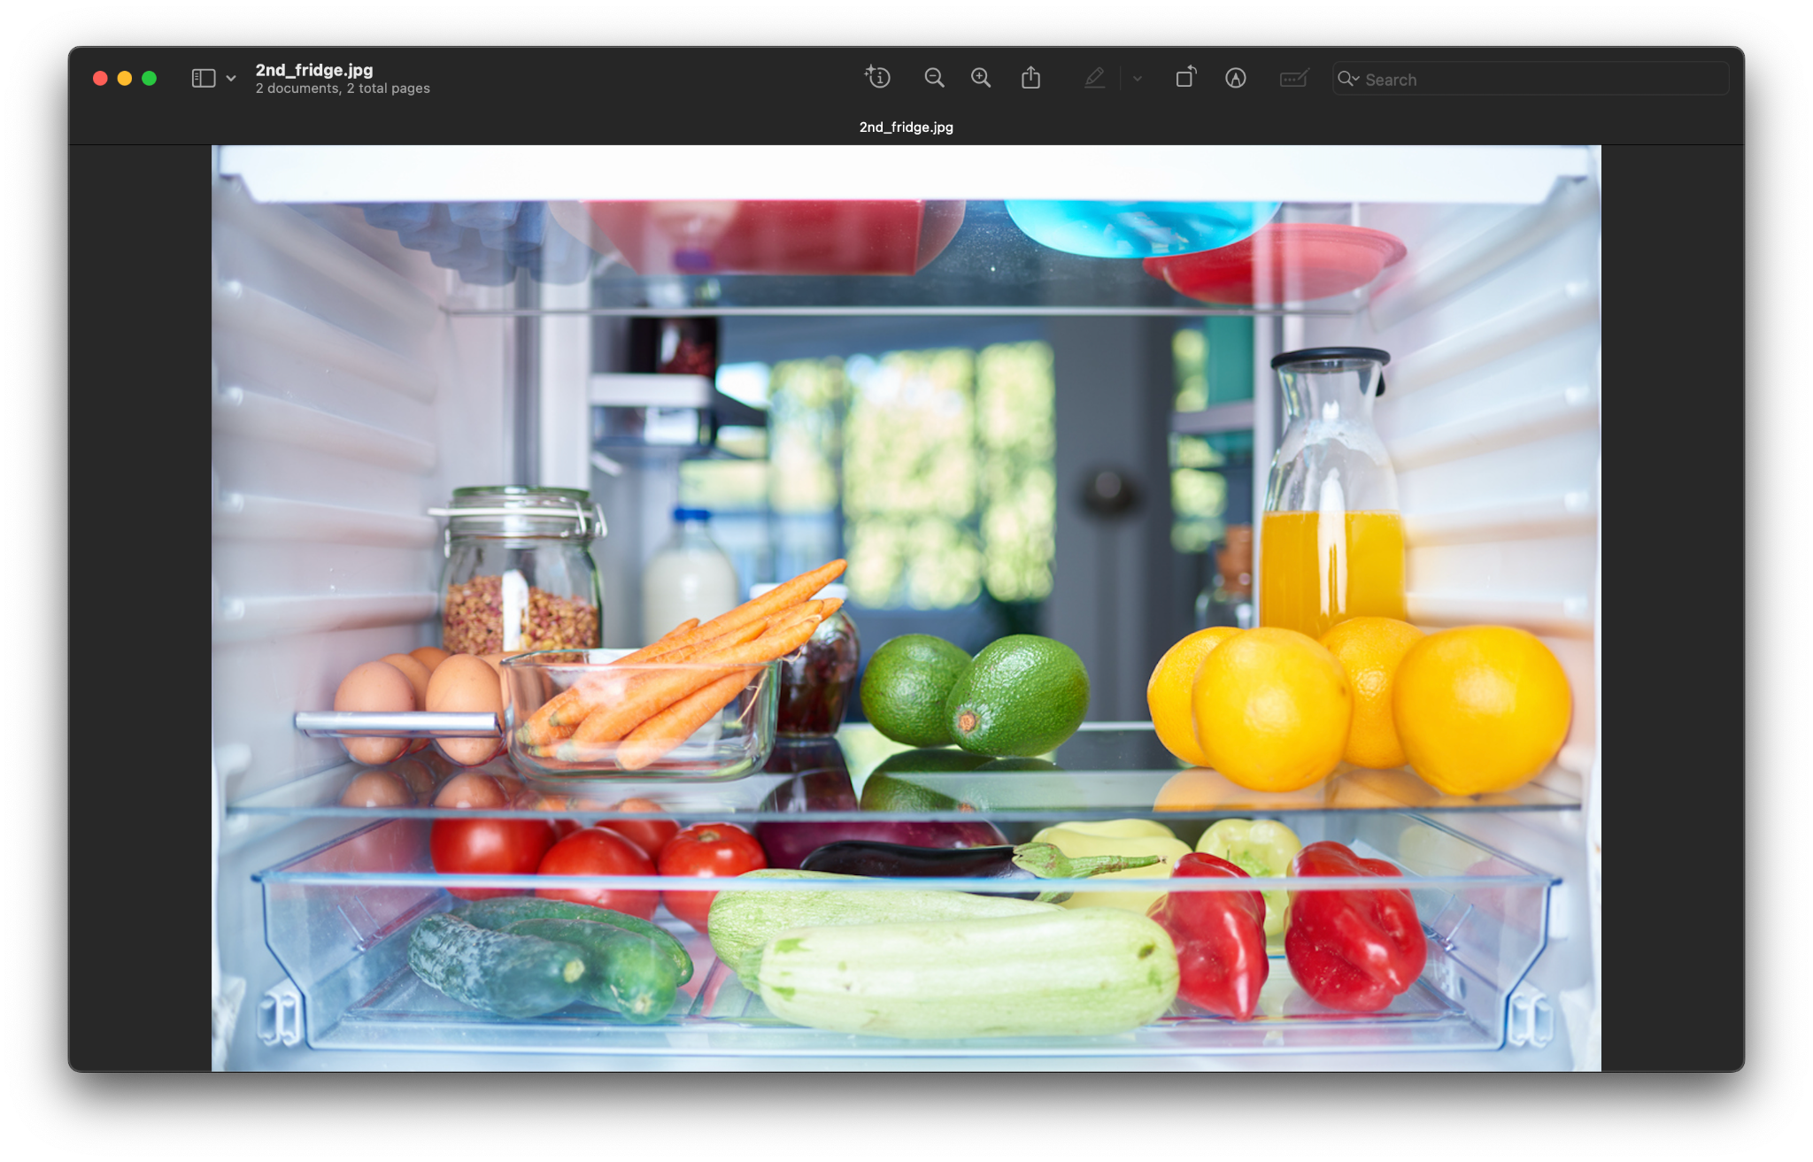
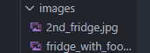
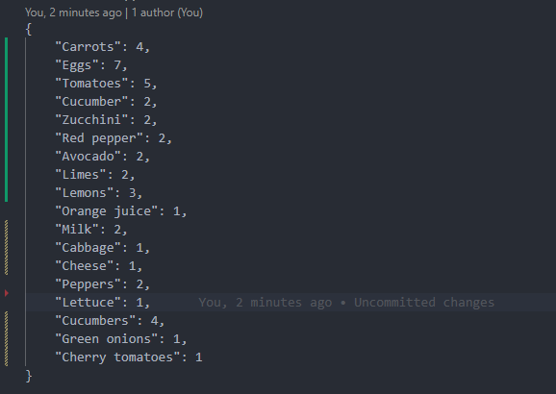
Safe People Team
Vision Progress
Highlights:
Detect from local images directory
Gyazo API for image hosting (we need a URL)
Multi image detection consolidated into one results dictionary
Consolidated Results

Slide 43
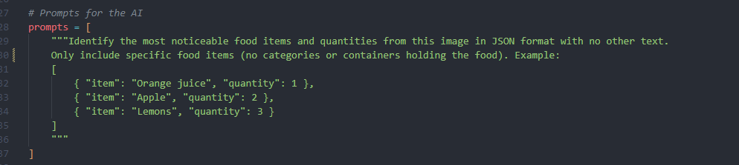
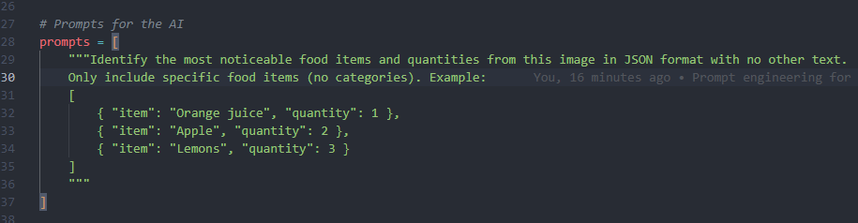
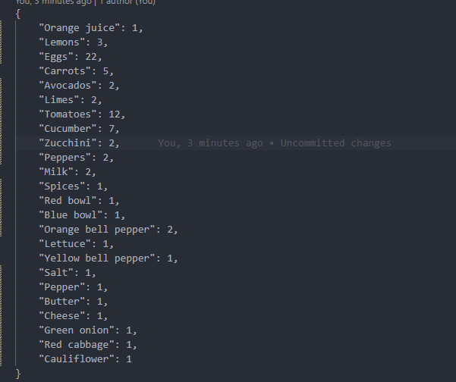
Safe People Team
The Prompt Battle

Slide 44
Safe People Team
Challenges This Week
01.
02.
03.
Searching for New Recipes Data
Loading Local Files Into Vision Agent
Preparing for Code Branch Merges
Problem: How do we return useful recipe data to the agent?
Problem: How do we load photos locally to llama instead of from urls?
Problem: Prepping code with comments for merge

Slide 45
Safe People Team
Next Steps for Week 48-49
Agent Chat - Front End
Pantry & Recipe
Asking Agent & Returns
Talk and get replies from Agent.
Show what’s in the Pantry and Recipes
Chatting with Agent and populating with Front-End
Notes:
Vision for final presentation: 1. Agent chat on the front-end - can talk and reply with Agent 2. Shows what’s in the Pantry and Recipes 3. Ask agent about those things and have it return to the front-end

Slide 46
Safe People Team
QUESTIONS?

Slide 47
Safe People Team
CS 489R
WEEK 49 Update (12/04/2024)
Purpose: Project Demo & Final Updates
Final Presentation

Slide 48
Safe People Team
Project Overview
An overview of the project development lifecycle.
Week 49: Key Update Areas
Project Summary
A summary of challenges and lessons learned.
Project Demonstration
Hands on demo of functionality.

Slide 49
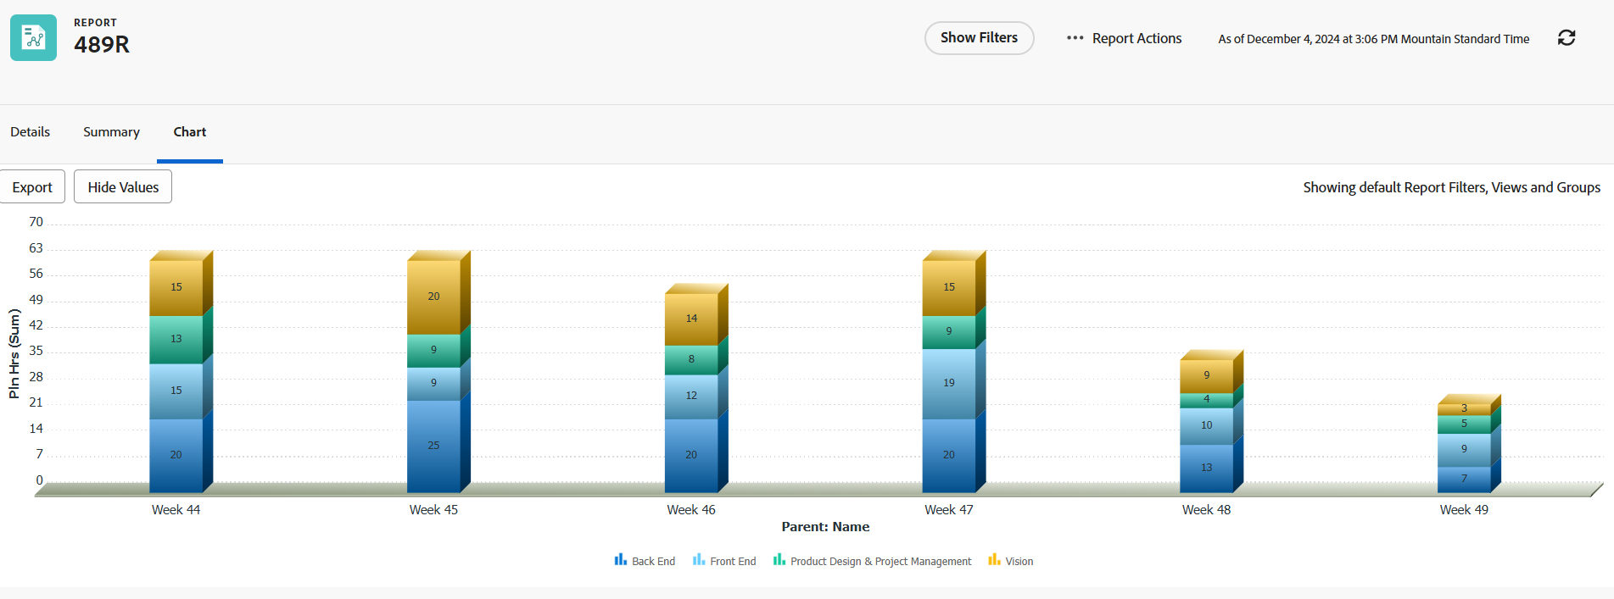
Safe People Team
Hours Composition

Slide 50
Safe People Team
Code Summary:
4 Branches
All Branches Merged to DEV
163 Commits
1433 Lines of Code

Slide 51
Safe People Team
Project Summary - Lessons Learned
Resource Management
Communication Issues
Managing Scope
Allocation
Utilization
Distributed Team
Comm Preference
Aligned to Time
Additional Features

Slide 52
Safe People Team
Project Summary - Challenges
Architecture Challenges
Front-end Challenges
Architecture, Models and Agents
Branding, Logos and User Interface
Back-end Challenges
Integration Challenges
Database, Payloads and Schema Design
How do we get each element to work with each other?

Slide 53
Safe People Team
Demo - What’s For Dinner®
Smart Enough to Know You and Your Kitchen, With Recommendations that Make Sense – And Make Dinner Easy

Slide 54
Safe People Team
QUESTIONS?

